Slide 1
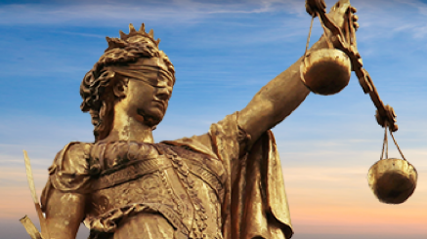
Advocate Roshani Poudyal
Partner, The Himalayan Lawyers
Nepal

Slide 2
Background
various issues of civil liberties and women rights were paramount during COVID lockdown
Different public discussion and interactions were conducted .
Every day media covered this vulnerable situation of civil liberties
Realizing this critical scenario, the petitioner (Speaker) decided to take this matter to the Apex Court as pro bono and social responsibility of lawyer.

Slide 3
Name of the Case: Mandamus
Name of the Writ Petitioners: Advocate Roshani Poudyal and Advocate Saroj K.Ghimire
Name of the Justices: Honorable Sapana Pradhan Malla and Honorable Prakash Kumar Dhungana
Writ Number: 076-WO-0962
Date of Final Decision: 05 August 2020

Slide 4
Major Orders: Mandamus and Directive orders
Ensure immediate relief and rescue mechanism including access to justice.
Ensure access to reproductive health services and protection of children on priority and formulate reproductive Rights Regulation.
Ensure adequate management of quarantine and protection of front liners.

Slide 5
Ensure protection of mental health .
Ensure protection of inclusive participation at all decision-making process to combat against COVID-19.
Protect right to employment.
Ensure right to privacy of infected & death of infected person.
Formulate pandemic law keeping women at center

Slide 6
Role of Lawyer who does pro bono in enforcing the judgment?
Lawyer who does pro bono is expected to involve in the process of implementation of the court decision so that people can enjoy their rights in timely basis.
Disseminating the decision through interviews, consultations and programs.
Conducting meetings and strategies for following up the implementation.
Collaborate with other agencies and individuals to create public pressure to the enforcement agencies by advocating and following up the issues and
Lobbying with the Bar Association and its pro bono lawyers for their involvement in securing access to justice and protection of civil liberties.

Slide 7
THANK YOU

