Slide 1
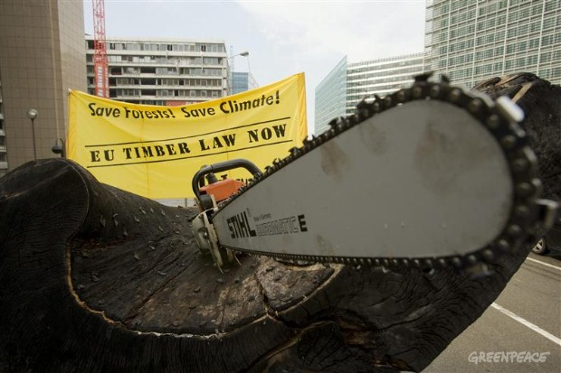
Using the Law to Advance Forest Campaigns
Asep Komarudin
Senior Forest Campaigner
Greenpeace Southeast Asia

Slide 2
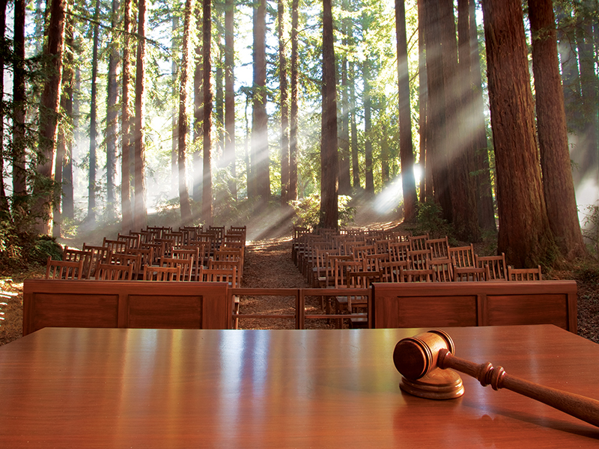
Examples of Past Legal Action
Court cases can be a great campaign opportunity for forests campaigns –
What does this look like?

Slide 3
Administrative Court : Revoking Enviromental Lisence
They claim the existing plant has had negative health impacts due to air pollution and has already harmed the livelihoods of fisherman, farmers and salt-makers in the area. Since the 600-megawatt plant opened five years ago, life in Cirebon has become increasingly precarious, 70-year old Astanajapura sub-district resident said. Fish are more difficult to find, rice crops suffer from air pollution, and fishponds don’t always produce fish, said Jusmadi, who like many Indonesians goes by one name.
https://news.mongabay.com/2017/04/indonesian-court-revokes-environmental-license-for-the-cirebon-coal-plant-expansion/

Slide 4
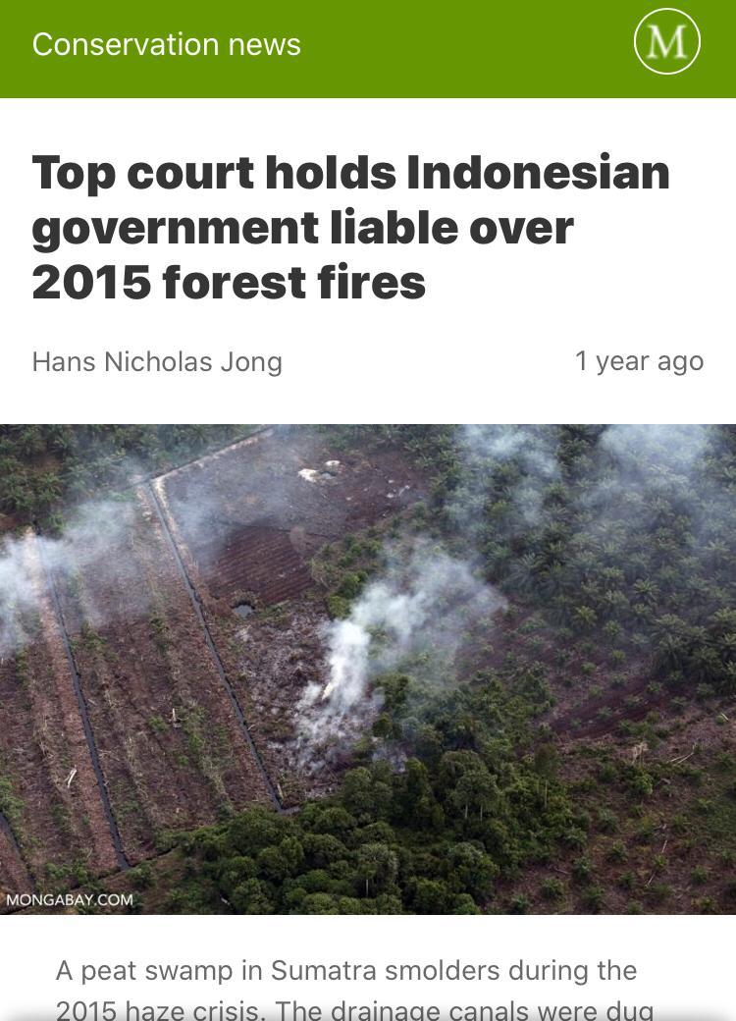
Citizen Law Suit: Indonesia Forest Fire 2015
JAKARTA — Indonesia’s highest court has upheld a ruling holding the government, including the president, liable for the disastrous forest fires and resultant haze that blanketed large swaths of the country in 2015.

Slide 5
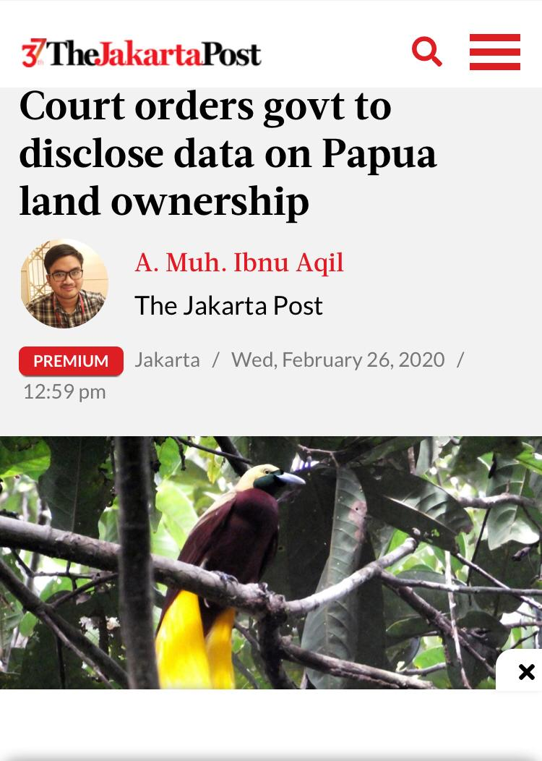
Freedom Of Information Cases

Slide 6
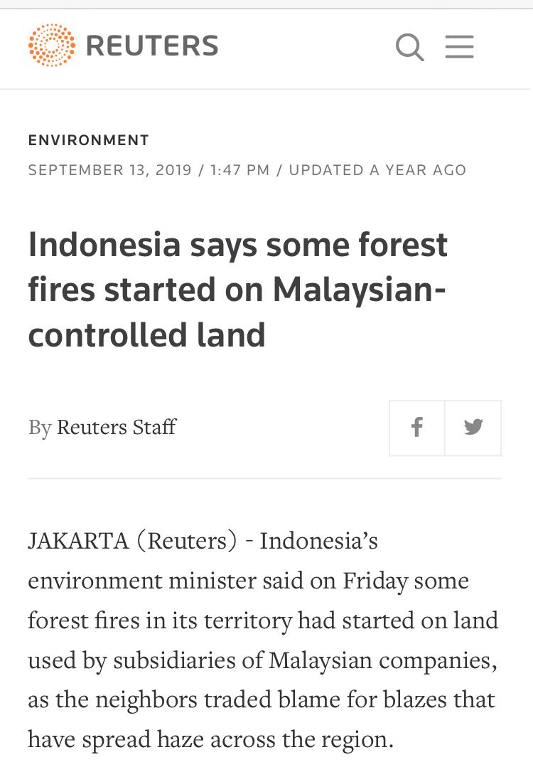
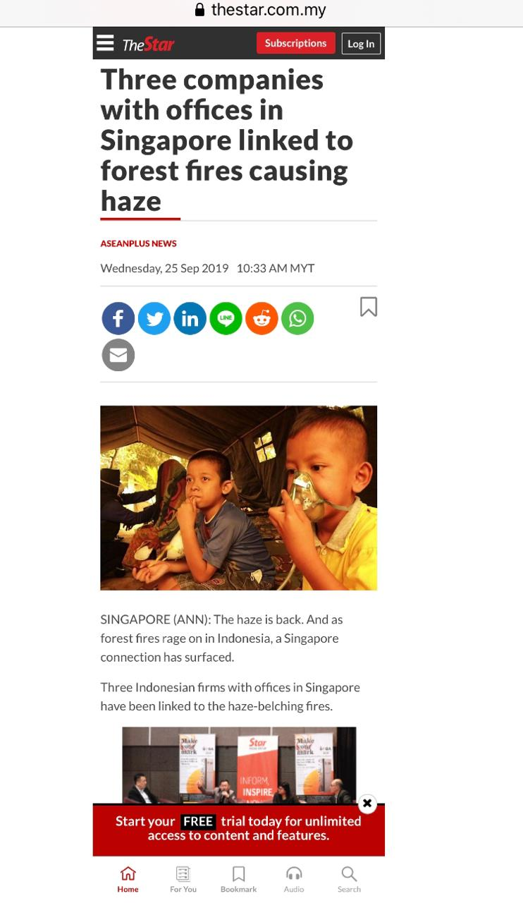
Transboundary Cases ?
https://www.greenpeace.org/southeastasia/press/3221/asean-haze-2019-the-battle-of-liability/

