Slide 1
How to set up a community legal needs survey
Vi Sengchanh BABSEACLE | Laos
Chris Walsh BABSEACLE | Australia
27 September 2020 10:00 – 11:30 (GMT + 7)
Notes:
Vi: Welcome and introducing the presentation (2 minutes)

Slide 2
Icebreaker
In Breakout rooms or the whole group
Introduce yourself and where you are from and who you for
Notes:
VI – 5 minutes
2 minutes introduce the activty
1 minute back to whole group

Slide 3
What is a needs assessment survey?
A needs assessment survey helps you to:
understand what a group or community members believe is the most important needs of their community
A needs assessment survey can be informal (discussion groups) or formal (written survey).
Notes:
Chris – (5 minutes)

Slide 4
What is a need?
In most needs assessment surveys, a need means something that specifically relates to a particular group or community. It's not usually a universal need, such as (food, love, etc.).
Critically, it's more than an individual need, as in I need a new mobile phone. Those may truly be needs, but they are not generally the types of needs that are assessed in needs assessment surveys.
Examples:
knowing how to deal with a legal issue
lack of community legal education
lack of access to legal advice or assistance
Notes:
Chris (5 minutes)
- Some surveys are very broad, and ask about any and all kinds of needs. Others are narrow, and limit themselves to learning more about one or two. Both kinds of surveys are common and helpful. Which to choose depends on what you want to find out.

Slide 5
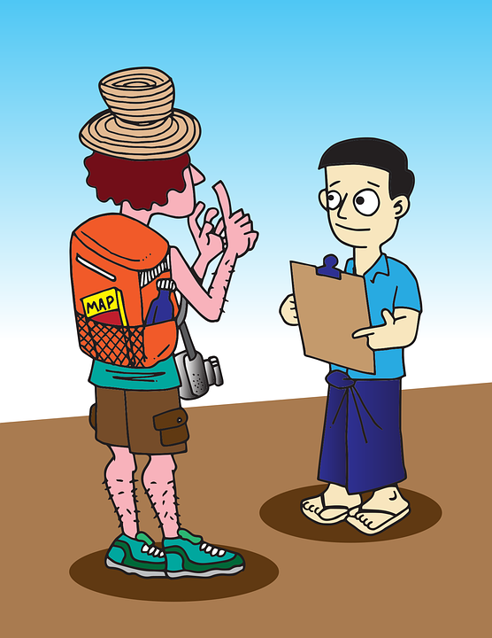
Characteristics of a community needs assessment survey
They have a pre-set list of questions to be answered
They have a pre-determined sample of the number and types of people to answer these questions chosen in advance
They are done by personal interview, phone, or by written response (e.g., a mail-in survey)
The results of the survey are tabulated, summarized, distributed, discussed, and (last, but not least) often used to plan an intervention or training.
Notes:
Chris (5 minutes)

Slide 6
Why should you do a needs assessment survey?
To learn more about what a community believe their needs are.
Anonymous surveys may help you better understand what the community needs are when community members are shy or even scared to tell you something publicly.
To learn about community needs you may not know even exist.
To make sure any community teaching, training or workshops are actually relevant to what the community actually needs.
Notes:
Chris (5 minutes)

Slide 7
Legal needs assessment survey outline
Demographic questions
Awareness of legal support or other services (where to go, whom to address the problem to)
Problems or disputes (e.g. questions about whether community members have face problems or disputes in the last 2 years)
Awareness of legal support
Notes:
Chris 5 minutes

Slide 8
Activity: What questions do you think you should ask in a community legal needs survey?
We are conducting a survey to better understand current legal awareness understanding throughout Laos PDR. The survey is for The National Institute of Justice (NIJ). I will not ask you your name and all the information you provide will be treated in the strictest confidence and you and your responses will remain anonymous. The survey takes 5 to 10 minutes of your time. Do you agree to participate in the research project entitled, Access to Legal Support, conducted by The Institute of Justice (NIJ)?
Breakout groups or on a piece of paper (15 minutes)
Demographic questions
Question 1_______________________________
Question 2_______________________________
Awareness of legal support or other services (where to go, whom to address the problem to)
Question 1_______________________________
Question 2_______________________________
Whole group share (10 minutes)
Notes:
Vi (25 minutes)
2 minutes explain the activity + provide a scenario
15 minutes breakout room collaborative activity
10 minute share and reflection

Slide 9
Case study example: BABSEACLE
Access to Legal Support Survey - Laos
Overview
Sections
Informed consent
Demographic Questions
Awareness of legal or support other services (where to go, whom to address the problem to)
Problems or disputes
Awareness of Legal Support
Using Google Forms or Survey Monkey (e.g. making tabulation easier!)
Walkthrough
https://docs.google.com/forms/d/1QlJwMJhhAa3m-8MpXP0PKYh6bWLo8kWiHHJDxt_vxt8/edit
Notes:
Vi – (10 minutes) –share the BABSEACLE survey and some of the questions plus why using Google forms is a good idea for tabulation

Slide 10
A step by step approach to carrying out a needs assessment
Questions your organisation needs to answer before designing a needs assessment survey:
What are our reasons for choosing to do this survey?
Are we ready to conduct this survey?
Decide how many people are going to be asked.
Decide what questions will be asked.
Decide who or what will ask the questions. (a person or a paper/digital survey).
Create a draft of the full survey.
Try out the survey on a test group.
Revise the survey on the basis of your test group feedback.
Revise the survey on the basis of your test group feedback. (e.g. Excel or Google Forms)
Revise the survey on the basis of your test group feedback.
Plan your intervention, project or education program.
Notes:
Chris - 10 minutes

Slide 11
Q&A
Ask us anything!
Notes:
Vi & Chris 5 minutes

Slide 12
Thank you!
Vi Sengchanh BABSEACLE | Laos
viphaphanh@babseacle.org
Chris Walsh BABSEACLE | Australia
c.s.walsh@babseacle.org
Notes:
Vi: Welcome and introducing the presentation

