Slide 1
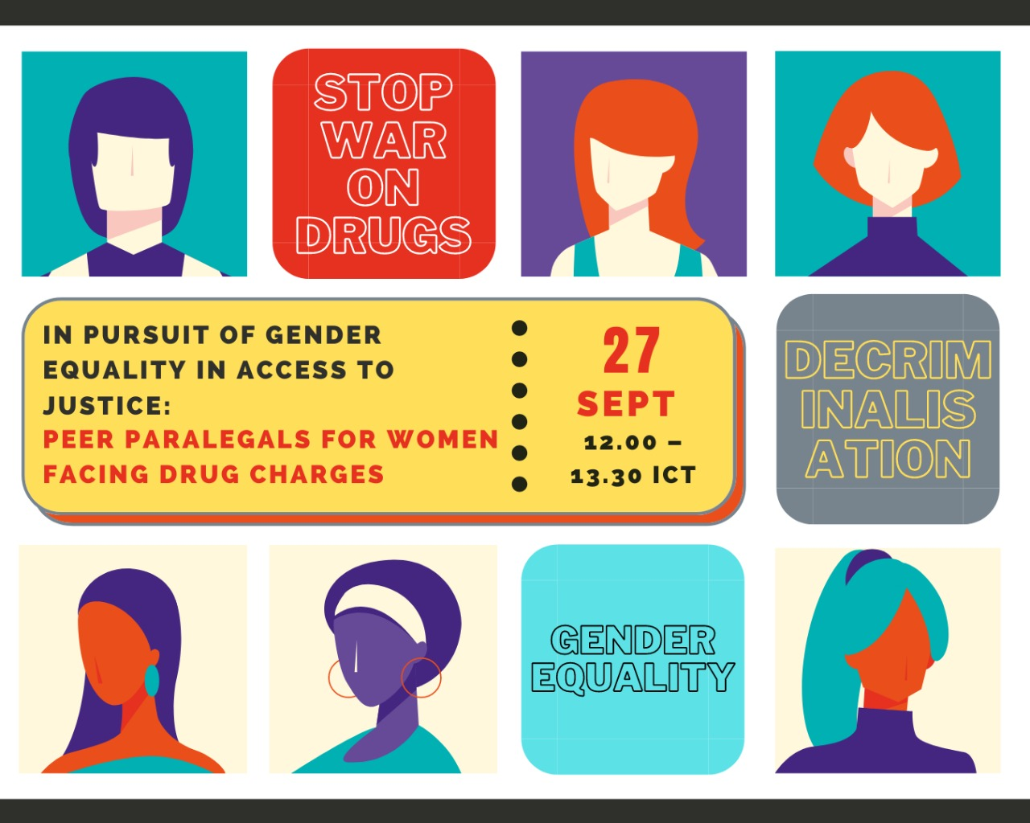

Slide 2
Who are we?
Non-government and community-based organisations that:
offer legal assistance
provide health services
advocate for human rights and drug policy reform
serve vulnerable groups, including people who use drugs, people who are in prison and on death row for drug offences, and people who face drug-related charges, especially women.
We work in Indonesia, the Philippines, and at regional and international levels.

Slide 3
Instructions
You will be taken through an interactive experience similar to ‘Choose your own adventure.’ There will be two stages, and you will be asked to decide between two options at each stage.
Use the symbols in the chatbox to make the decision, and select ‘yes’ or ‘no’.
Each decision will take you to a different breakout room.
In the breakout room, a facilitator will explain the consequence of your decision and ask guiding questions to discuss further.
There will be a Q&A session at the end of the two stages.
Please use your “Reaction Icons” (Thumbs Up, Stars, etc) to express your reactions throughout the experience.
If you need interpretation, it is only available in room 1 (sorry!)

Slide 4
Stage 1

Slide 5
You start another day with your spouse and kids. Money's been a little tight. Your friend gave you this pill to try last night that helped you stay awake during your night shift. But the kids are still hungry and crying. Your spouse looks tired. You're afraid because whenever he's unhappy he takes it out on you, sometimes physically. He says he needs help with something.
Do you help him?
Yes
What are some of the vulnerabilities you face as a woman?
What role does drugs play in the vulnerabilities you face?
What gender roles are there in many Asian households that may influence women’s decision making/bargaining power?
No

Slide 6
Stage 2

Slide 7
YES
You agree to help

Slide 8
He says he needs a package delivered, it’s easy, good money. It’s arranged. You’ll meet with this person at a mall.
The next day, you’re waiting for the person to arrive. You’re nervous but you quickly spot him. You walk over and make the exchange. Suddenly everything becomes blurry. It turns out the person you’re supposed to meet is an undercover police.
Why did you choose this option?
How do the circumstances you face in this situation a result of your vulnerabilities as a woman?
What kind of tactics/power do law enforcement have that are inconsiderate of women’s circumstances?
What rights can you claim or support you can turn to, to deal with law enforcement?

Slide 9
You remember a friend of a friend who is a paralegal that specialises on drug cases.
Do you call the paralegal OR appeal to the Public Defender?
Call the paralegal
Ask the Public Defender for help

Slide 10
NO
You say you don’t want to be involved

Slide 11
He looks disappointed but luckily doesn’t push you further.
The next day, there is a banging on the door. You open to see policemen. They have orders to search your house. You’re alone so it’s difficult to resist.
They find meth hidden in one of your drawers. You don’t know anything about it. But the police don’t believe you.
You can decide to confess and enter plea bargaining (e.g. to enter drug rehabilitation instead of prison) OR become an informant for the police and blame your partner for the meth.
Why did you choose this option?
How are the circumstances you face in this situation a result of your vulnerabilities as a woman?
What kind of tactics/power do law enforcement have that do not consider a woman’s circumstances?
What rights can you claim or support you can turn to, to deal with law enforcement?

Slide 12
You can decide to confess and enter plea bargaining (for rehabilitation instead of prison)
OR
become an informant for the police and blame your partner.
Confess and plea bargain
Blame your partner

Slide 13
Stage 3

Slide 14
Call the paralegal
The paralegal helps with your case and your sentence gets reduced.
How have the drug policies in place led to where you are now?
What other circumstances do you think women who are involved with drug offences can face?
What kind of processes did you have to go through from point of arrest to get here?
What could have been done for you to get the support you needed instead of having to go through the criminal justice process?
How reforms can be made to reimagine an alternative reality?

Slide 15
Ask the public defender for help
The public defender helps but you end up awaiting trial for a whole year. During that time, you're stuck in jail or pre-trial detention.
How have the drug policies in place led to where you are now?
What other circumstances do you think women who are involved with drug offences and/or in prison can face?
What kind of processes did you have to go through from point of arrest to get here?
What could have been done for you to get the support you need instead of having to go through the criminal justice process?
What reforms can be made to reimagine an alternative reality?

Slide 16
Decide to confess
You can go to a rehabilitation center but you have to pay the police. Moreover, you're surprised that it is like a prison. You start attending paralegal trainings in the detention facility.
How have the drug policies in place led to where you are now?
What other circumstances do you think women who are involved with drug offences and/or in prison can face?
What kind of processes did you have to go through from point of arrest to get here?
What could have been done for you to get the support you need instead of having to go through the criminal justice process?
What reforms can be made to reimagine an alternative reality?

Slide 17
Blame your partner
You blame your partner. He ends up in prison. But that means, you're left with all the responsibility of caring for the family.
How have the drug policies in place led to where you are now?
What other circumstances do you think women who are involved with drug offences can face?
What kind of processes did you have to go through from point of arrest to get here?
What could have been done for you to get the support you needed instead of having to go through the criminal justice process?
How reforms can be made to reimagine an alternative reality?

Slide 18
Any questions to ask?
Comments to share?

Slide 19
THANK YOU!
Indonesia Act for Justice (AKSI): https://www.facebook.com/DMT127/
Community Legal Aid Institute (LBHM), Indonesia: https://lbhmasyarakat.org/
IDUCare, Philippines: https://www.facebook.com/IDUCAREHomeOfHope
StreetLawPH, Philippines: https://twitter.com/streetlawp?lang=en
NoBox Philippines: https://nobox.ph/
International Drug Policy Consortium: http://idpc.net/

