Slide 1
MEASURING AND REPORTING IMPACT OF PRO BONO INITIATIVES TO STRENGTHEN ACCESS TO JUSTICE
Dr Christopher Walsh
Senior Research Analyst and Policy Advisor (BABSEA CLE)
Associate Prof. of Education & Program Director (Torrens University Australia)

Slide 2
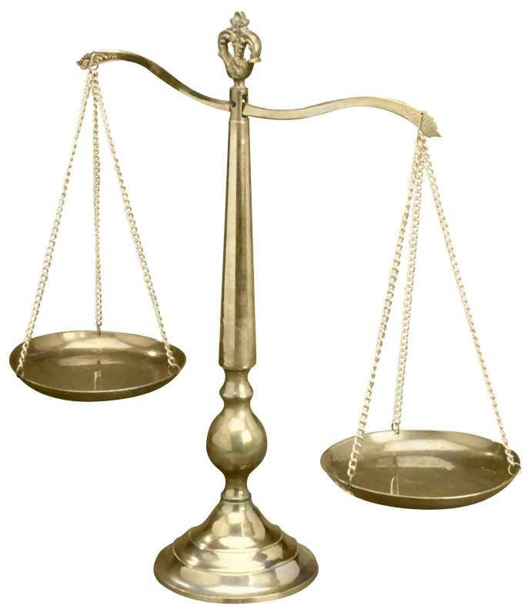
Overview
Why measure impact?
‘Good’ key performance indicators.
Sample survey questions.
Characteristics of effective surveys.
The survey is a critical instrument that clinics can use to measure their impact.
Provide a data analysis plan and guidelines.
Knowledge beautiful: Visually representing data for for stronger impact.

Slide 3
Why measure impact?

Slide 4
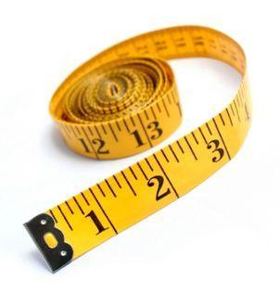
Why measure impact?
Measuring impact is the recognised way in which you show the value the CLE program is delivering to its beneficiaries and society as a whole.
Surveys are an instrument that clinics themselves can use to measure their impact on future law professionals and advocates for justice.
Why it matters?
We want to know if the program had an impact and the average size of that impact.
Pathway to more funding…

Slide 5
‘Good’ key performance indicators (KPIs)
A Key Performance Indicator (KPI) is a measurable value that demonstrates how effectively a clinic is achieving key access to justice objectives. Clinics can use KPIs to evaluate their success at reaching targets.
Sample CLE program objective:
To develop university law clinics that transform law students into knowledgeable, skilled, and ethical lawyers who:
are sensitive to the injustices of the legal system for the poor and otherwise disadvantaged
will either engage in public interest law themselves or support lawyers who do this work.
So what is the KPI?

Slide 6
The KPI is a measurable value that demonstrates how effectively a clinic is achieving its stated objectives...or not...

Slide 7
Sample survey questions to measure whether the KPIs have been realised
 | Strongly agree | Agree | Disagree | Strongly disagree
I believe it is important for lawyers to provide pro bono services to poor or disadvantaged clients
I will engage in pro bono work in the future
You measure something measurable that is directly realated to the

Slide 8
The survey is a critical instrument that clinics can use to measure their impact
But only if it is well designed well, easy to use and you REALLY know how to analyse the data collected…
Himelein, K., Menzies, N., & Woolcock, M. (2010). Surveying justice : a practical guide to household surveys. Justice and development working paper series ; no. 11. Washington, DC: World Bank.
http://documents.worldbank.org/curated/en/2010/01/12600211/surveying-justice-practical-guide-household-surveys

Slide 9
Characteristics of effective surveys
Collects sufficient demographic information
Is focused and to the point
Extremely clear questions
One part questions
Only use other or neutral when you can ask for explanation or further details
Logical sequencing of questions
Provide incentive to increase motivation (share results)
Know how you will analyses the results BEFORE you administer the survey

Slide 10
Provide/develop a data analysis plan and guidelines for data analysis (and use it!) to drive your survey design
Otherwise you might not collect ‘good’ data…
Survey monkey has great free advice!
https://www.surveymonkey.com/mp/survey-guidelines/

Slide 11
Knowledge beautiful! Consider visually representing your data for for stronger impact and to make it accessible to diverse audiences

Slide 12
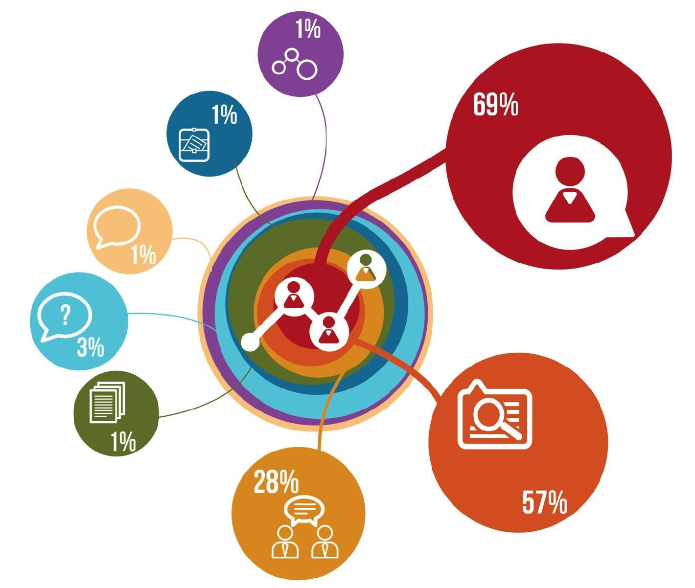
Did you have the opportunity to reflect on your experiences and discuss the impact of the law and legal system on clients and attendees with your supervisor and fellow students as part of a planned meeting or class?

Slide 13
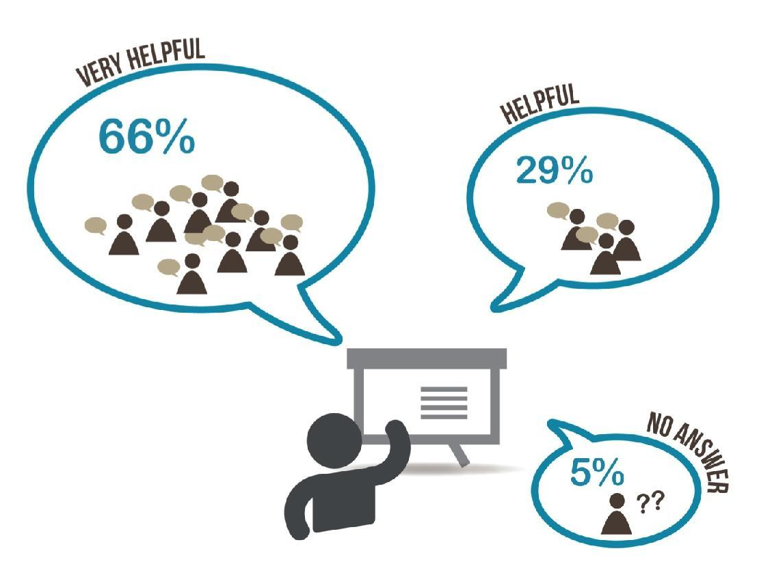
How helpful was the classroom/training component in preparing you for the experiential component of the clinic?

Slide 14
Did your primary supervisor for the experiential component also teach in the classroom/training component?

Slide 15
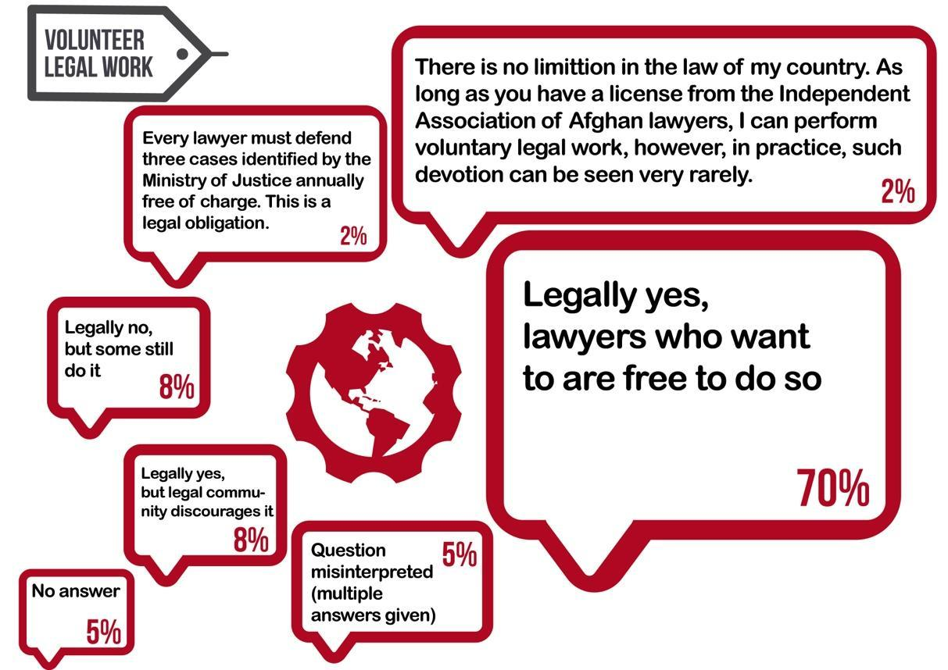
In your country, as a lawyer can one do volunteer legal work (without pay, pro bono)?

Slide 16
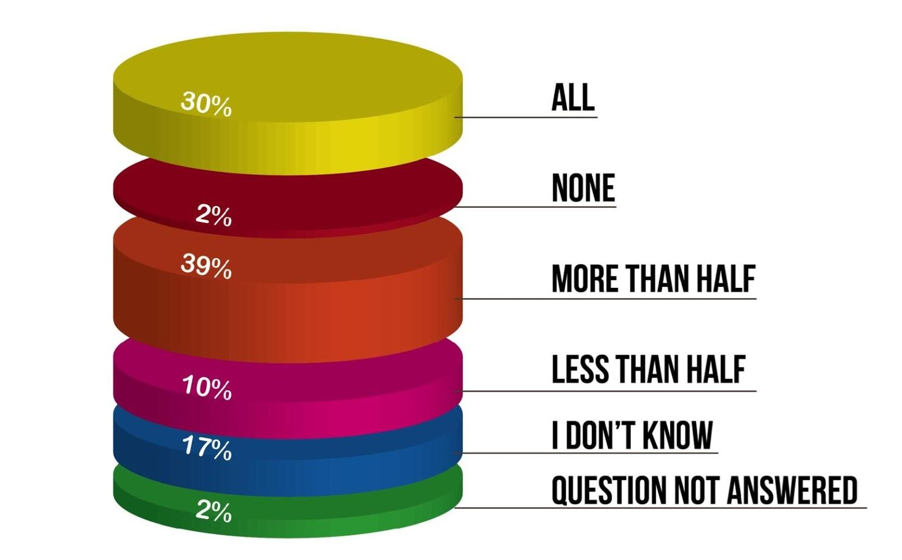
Approximately what portion of the clinic’s clients or attendees at presentations were low income or otherwise unable to obtain legal assistance/information in your community?

Slide 17
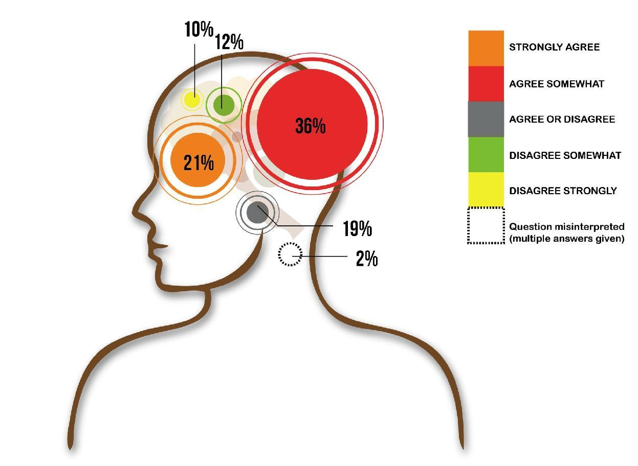
My clinic was highly specialized in that we concentrated our work in one area of the law (eg. criminal, family law, employment law)

Slide 18
3 Key points to take away…
Surveys need extremely clear questions…
Develop a data analysis plan and guidelines for data analysis (and use it!) to drive your survey design
Ask, can I represent my data visually for greater impact?

Slide 19
Thank you

