Slide 1
& Ideas to Do Pro Bono Cases
Criminal Cases in Particular

Slide 2
POWER KICKS

Slide 3
Tips in handling Pro Bono cases (Criminal case in particular)
Priorities & Organize
Write it down
Explain and communicate.
Rules (Ethic & When they can call you? )

Slide 4
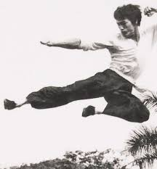
Know what you are doing
(Don’t do cases you don’t know)
Identify the official spoke person
Connection / networking (Get help)
Keep in Control (Your client & your emotion )
Suck in up

