Slide 1
3RD Annual Asia Pro Bono Conference:
DNA of Pro Bono Partnerships
Susan Brooks
& Alexis Duecker
October 2014

Slide 2
University Context: Four Components of our Experiential Learning Program
Pro Bono
Clinical Program
Externship Program (“Co-op”)
Trial Advocacy

Slide 3
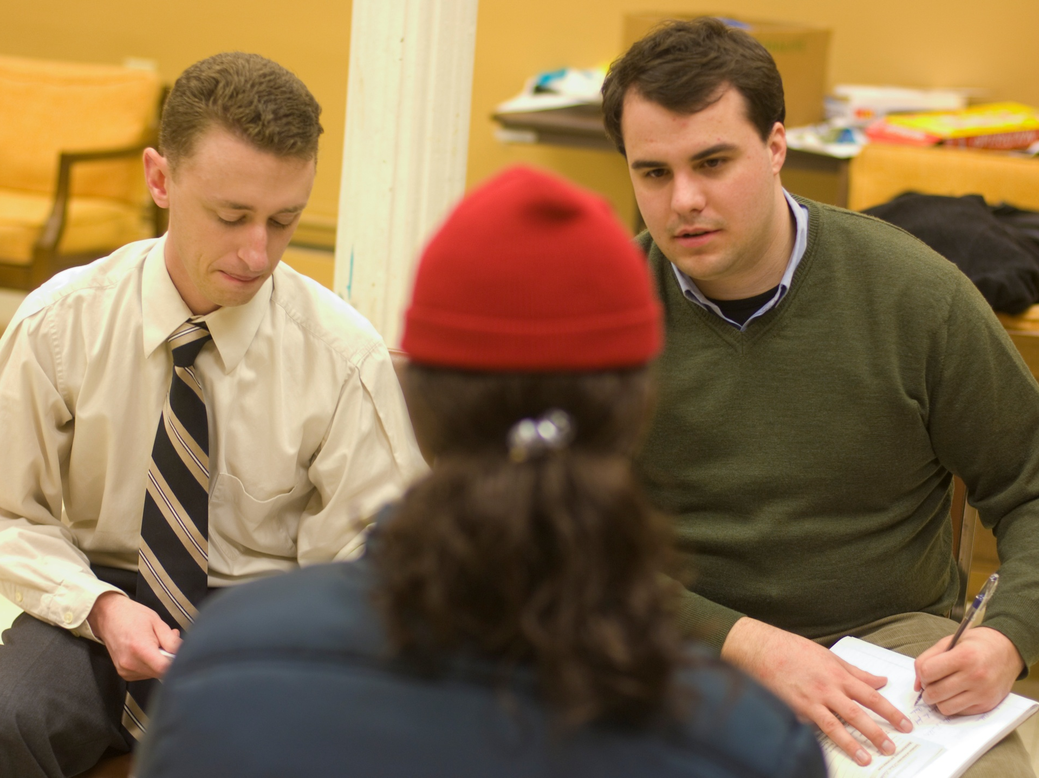
:
All Drexel Law students provide at least 50 hours of law-related Pro Bono Service
.

Slide 4
Over half of our students choose to do much more than 50 hours!
Students may complete up to 25 hours in first year
Wide range of school-sponsored projects
Students may also choose a project on their own, or through a student organization

Slide 5
Pro Bono Statistics
Class of 2014
More than 14,000 pro bono hours served, an average of 102 hours/student
67% of the class exceeded the 50 hour requirement
14 of those students provided over 200 hours of service and 2 students provided over 700 hours of service
Class of 2013
More than 13,000 pro bono hours served, an average of 92 hours/students
71% of the class exceeded the 50 hour requirement
11 of those students provided over 200 hours of service and 1 student provided over 600 hours of service

Slide 6
Direct Legal Services Projects:
  Criminal Record Expungement
  Senior Help-Line
  Estate Planning
  Low Income Tax Assistance
  Small Business Assistance

Slide 7
International Projects/Partnerships:
BABSEA –CLE
Summer Internship!!!

Slide 8
Youth Advocacy Projects:
Marshall-Brennan Constitutional Literacy Project
Disability Benefits Advocacy for Homeless Youth

Slide 9

Student Testimonials:
“The pro bono program has allowed me to gain hands-on experience working with clients to make a difference in their lives. The work has been fulfilling and educational – I only wish I could have done more hours on more projects.”
“It’s an excellent way to give back to the community and take on work you may not even know exists.”

Slide 10
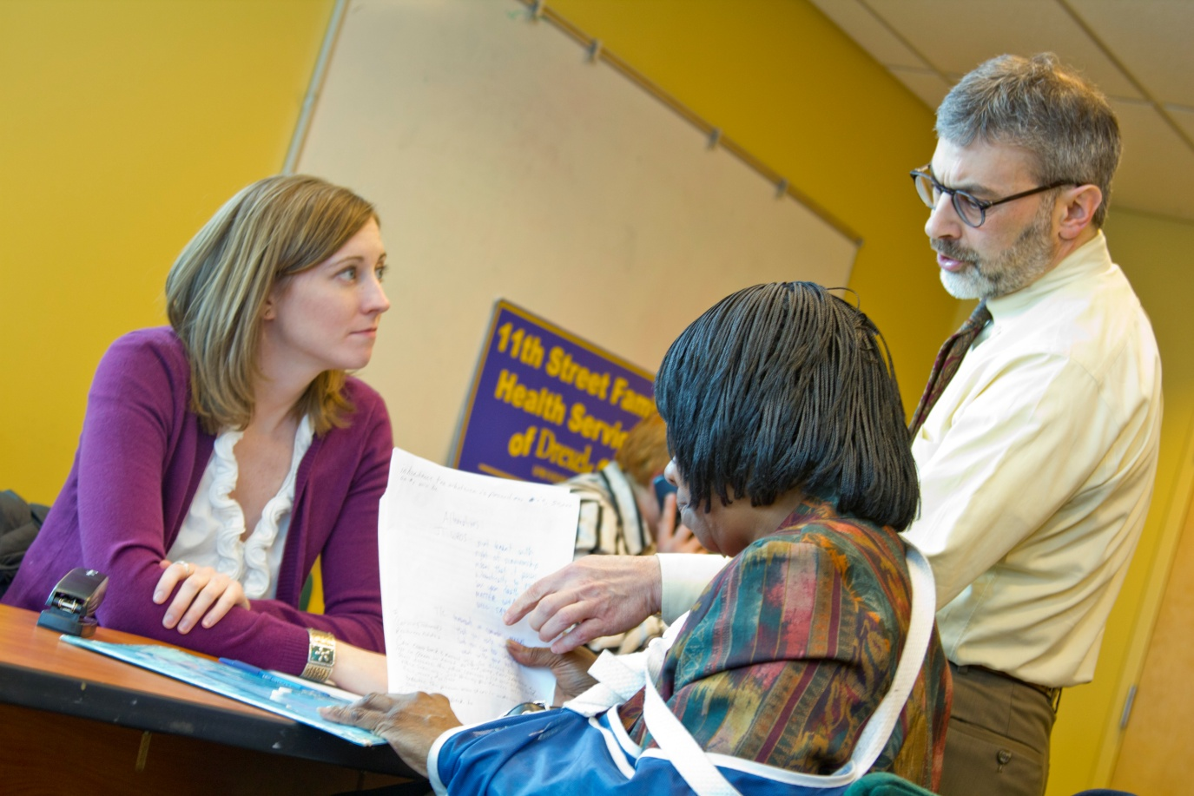
Supervisor Testimonials:
“Eric’s work in the pro bono program will provide permanent value for pro se litigants. I appreciated the opportunity to work with him to produce this important work product.”
“Cate’s presence and participation is a huge boon to the unit – we are lucky and happy to have her.”

Slide 11
What’s the DNA???
DO COMMIT RESOURCES
NURTURE RELATIONSHIPS
ASSESS CONTINUOUSLY

Slide 12
OTHER KEY INGREDIENTS:
LEADERSHIP
COMMUNICATION
MENTORSHIP
ACCOUNTABILITY
MUTUALITY/RECIPROCITY

