Slide 1
Introduction
Who am I ?
Chong Yin Xin, Samantha

Slide 2
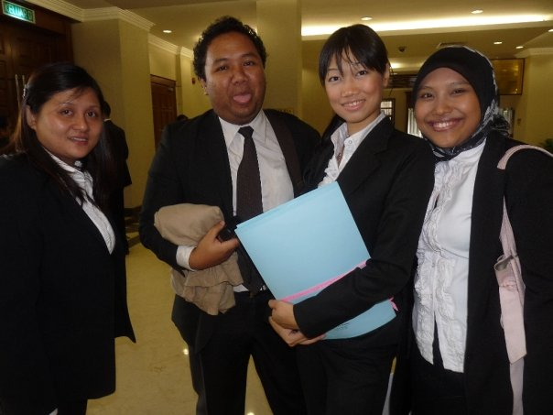
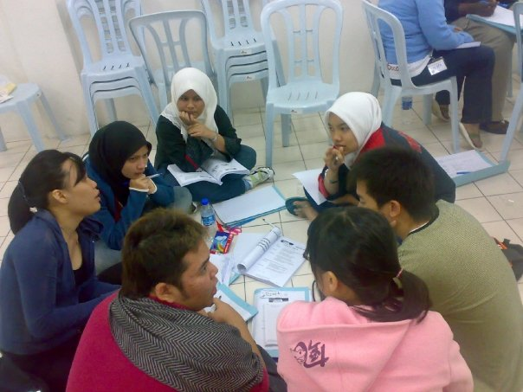
I was a student,
who joined CLE in UM

Slide 3
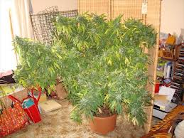
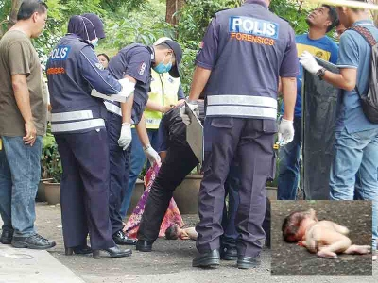
I was a Deputy Public Prosecutor
With the Attorney General’s Chambers…

Slide 4
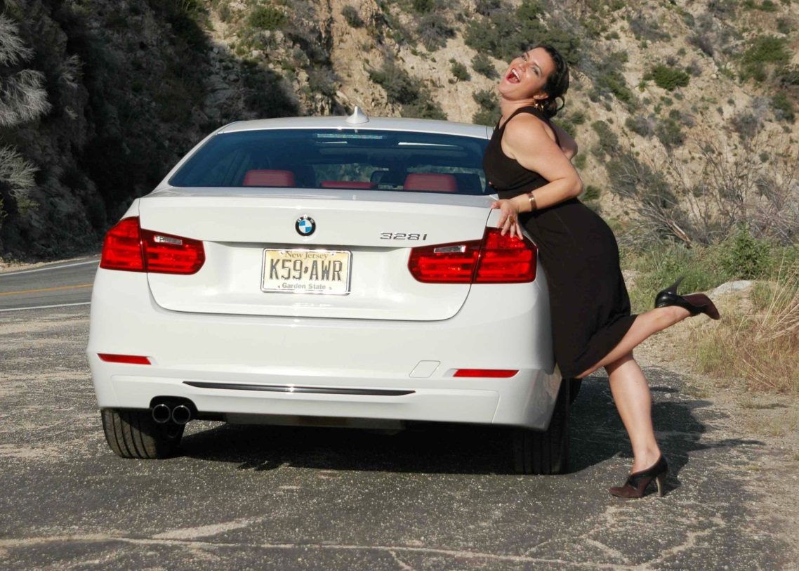
What the society think I am doing

Slide 5
What other lawyer think I am doing ?
Lawyers who don’t know me.
Lawyers who know me.

Slide 6
What my client think I do ?
Too young Perhaps?

Slide 7
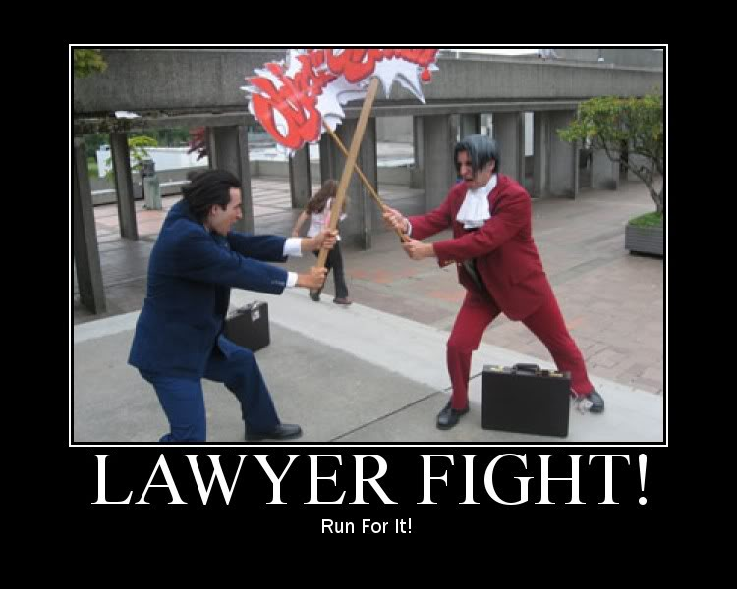
What My family think I am doing ?

Slide 8
What I think I am doing ?

Slide 9
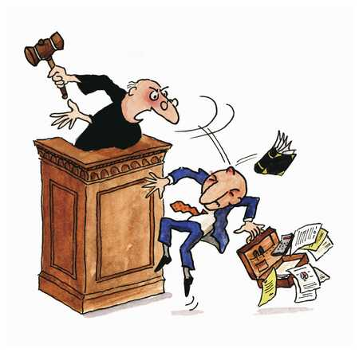
What I am actually doing ?
Criminal law Practitioner
Criminal Defense counsel for the Kuala Lumpur National Legal Aid Foundation (NLAF)
Pro Bono Lawyer
Working Committee For NLAF
Organizing Committee for Community Outreach Program for LAC

