Slide 1
Passion for Pro Bono: Passion for Justice
Dr. Panarairat Srichaiyarat
Khon Kaen University, Thailand
(presented at the 3rd Asia Pro Bono Conference, Singapore , 3 October 2014)

Slide 2
Pro Bono Publico : for the public good
Providing professional service without payment or at a reduced rate of payment.

Slide 3
Should the meaning of pro bono be limited to this understanding?

Slide 4
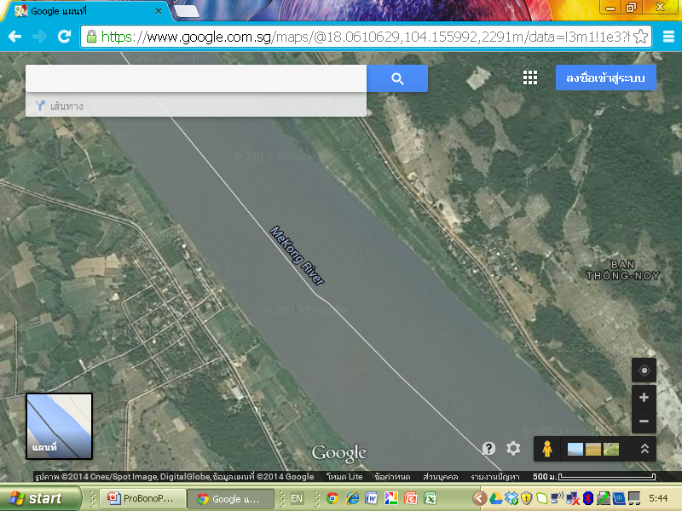

Slide 5
Fact:
A Thai woman went across the Mae Kong river by boat and brought back 1.5 pills of methamphetamine.
She got arrested by 2 policemen and was brought to a hospital for searching.
Before a doctor started the searching, she handed the 1.5 pills placed in a cell phone cover to the doctor.

Slide 6
She was charged with importation and possession of narcotics (category I).
She confessed before the trial that she bought the methamphetamine from a Lao for her own consumption.

Slide 7
What should be her punishment?
Death penalty? / Life imprisonment?
25 years?
10 years? /5 years?
1 year? / Probation?
Not at all?

Slide 8
Please rely on your sense of justice!

Slide 9
Thai Law: NARCOTICS ACT
B.E. 2522 (1979)
Section 65 Any person who …imports … the narcotics of category I in violation of Section 15, shall be liable to imprisonment for life and to a fine of one million to five million baht.
Section 4 In this Act :
"import" means bring or order into the Kingdom;

Slide 10
Section 15 No person shall …import… or possess narcotics of category I, unless the Minister permits for the necessity of the use for government service.

Slide 11
If you were the judge, will you try to follow your sense of justice or let her go to the prison for life?

Slide 12
The First Instance Court vs. The Appeal and Supreme Court

Slide 13
“The hardest job of the first year is to lop off your common sense, to knock your ethics into temporary anesthesia. Your view of social policy, your sense of justice - to knock these out of you along with woozy thinking, along with ideas all fuzzed along their edges. You are to acquire ability to think precisely, to analyze coldly, to work within a body of materials that is given, to see, and see only, and manipulate, the machinery of the law.”
(K.N. Llewellyn, The Bramble Bush: On Our Law and Its Study )

