Slide 1
UQ Pro Bono Centre student voice and input 3rd Annual Asia Pro Bono Conference 2 – 4 October 2014

Slide 2
UQ Pro Bono Centre overview
Pro bono activities
External or at UQ
High Schools Program
Manning St Project
(Caxton Legal Centre)
Pro Bono Roster
CLE Program
LAWS5180

Slide 3
Pro bono roster activities

Slide 5
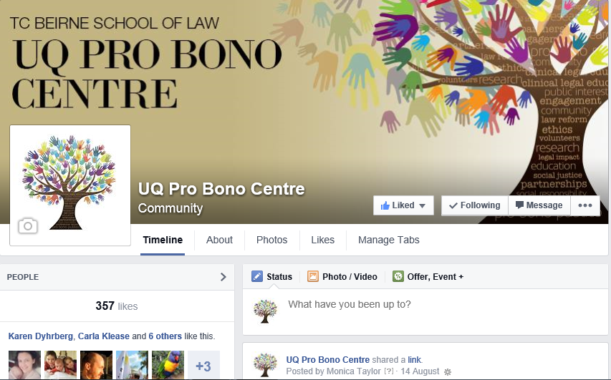

Slide 6
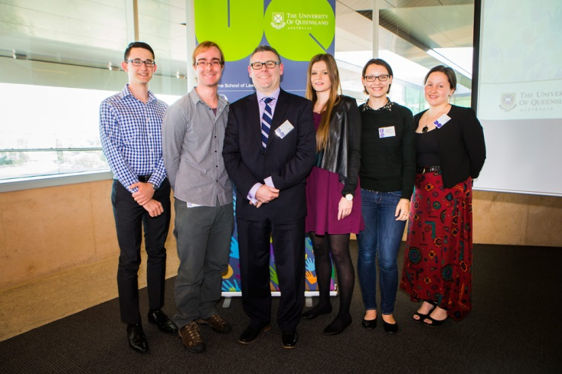
Student Advisory Panelists with guest speaker at 2014 Pro Bono Awards Lunch

Slide 7
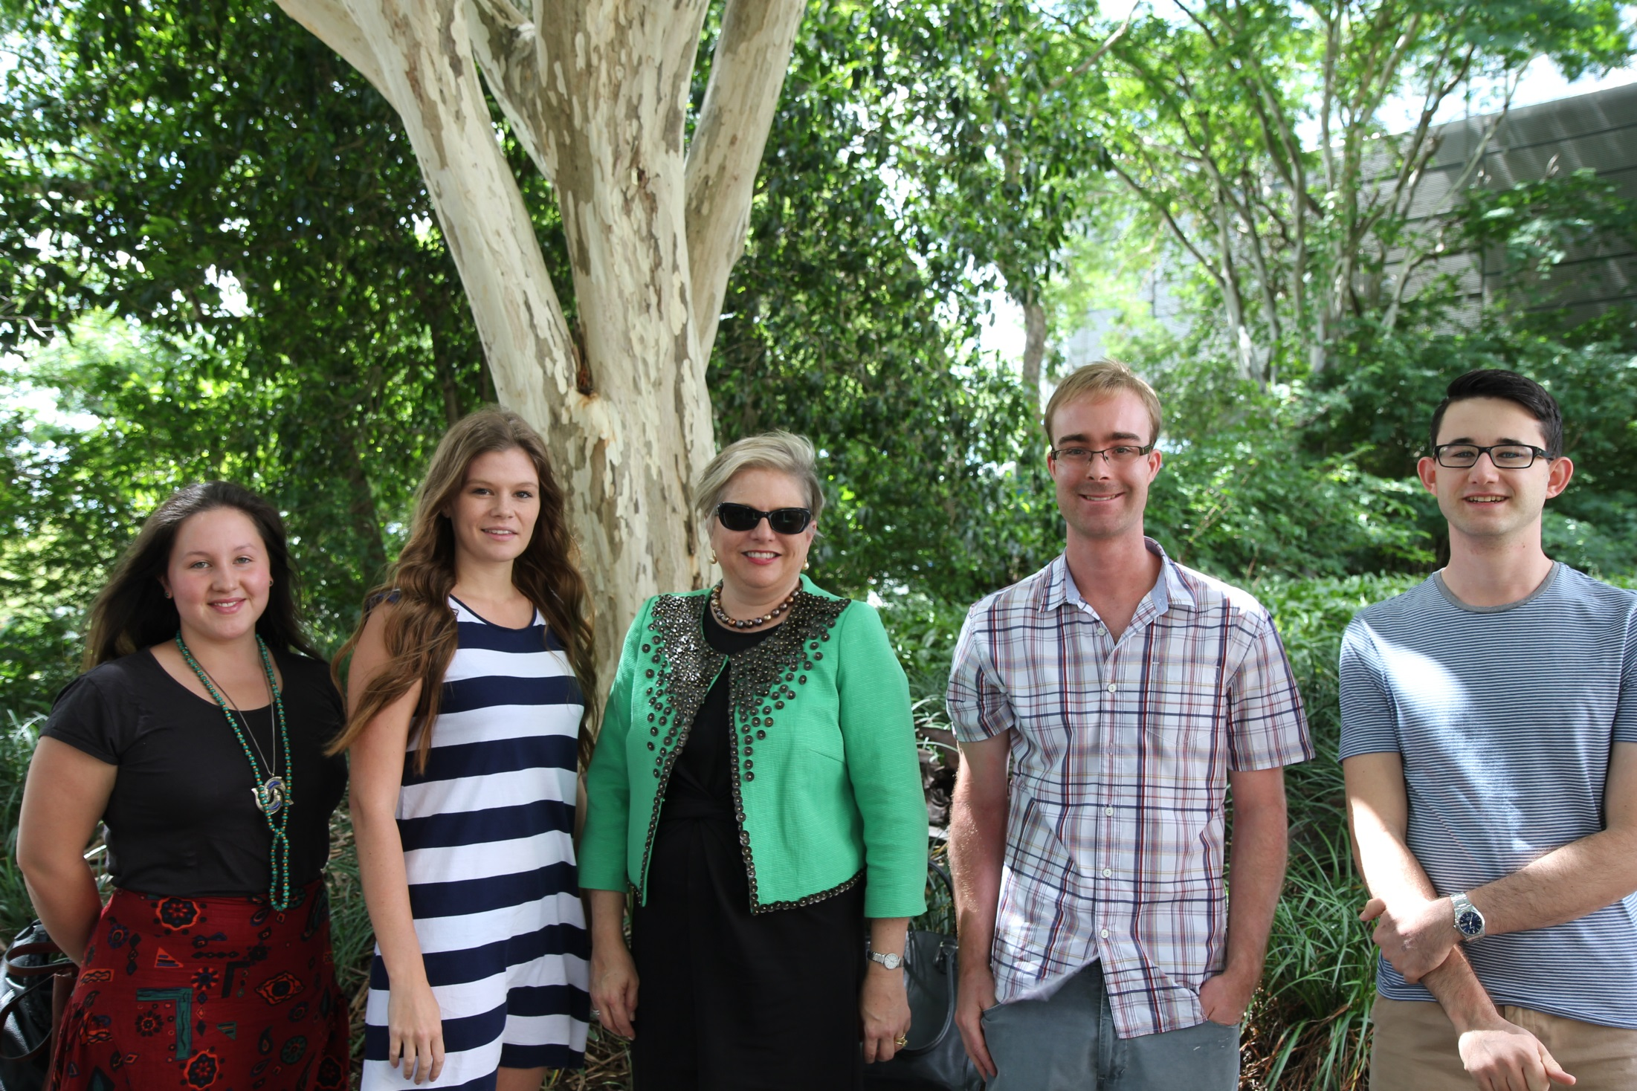
SAP with Kathryn McMillan QC (Practitioner-In-Residence)

