Slide 1
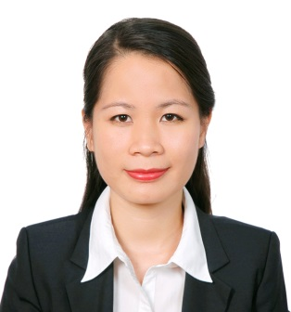
Who I am?

Slide 2
I am
Merger and acquisition Vietnamese lawyer
Interested in legal education and volunteering activities
Never want to stop involving in pro bono work where I can find the true meaning of my life
Have hobbies like swimming, practicing yoga, cooking and learning about musical instruments

Slide 3
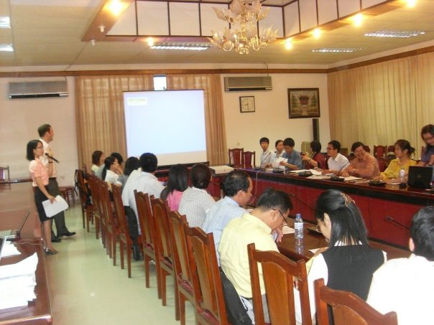
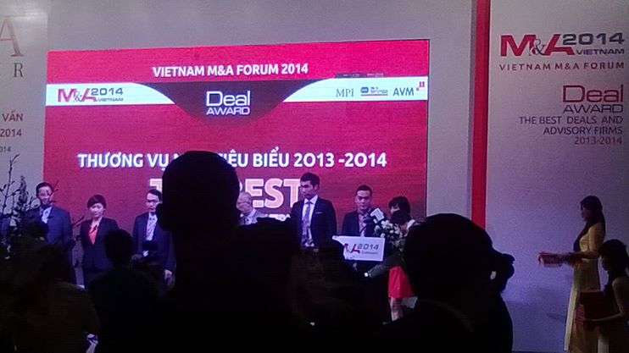
What I do in professional life and probono?
Week-day job | Week-end activities

Slide 4
What do my friends think I do?
Lawyer’s work but super busy!

Slide 5
What do my family think I do?
Something complex and difficult to understand like “buying a company”

Slide 6
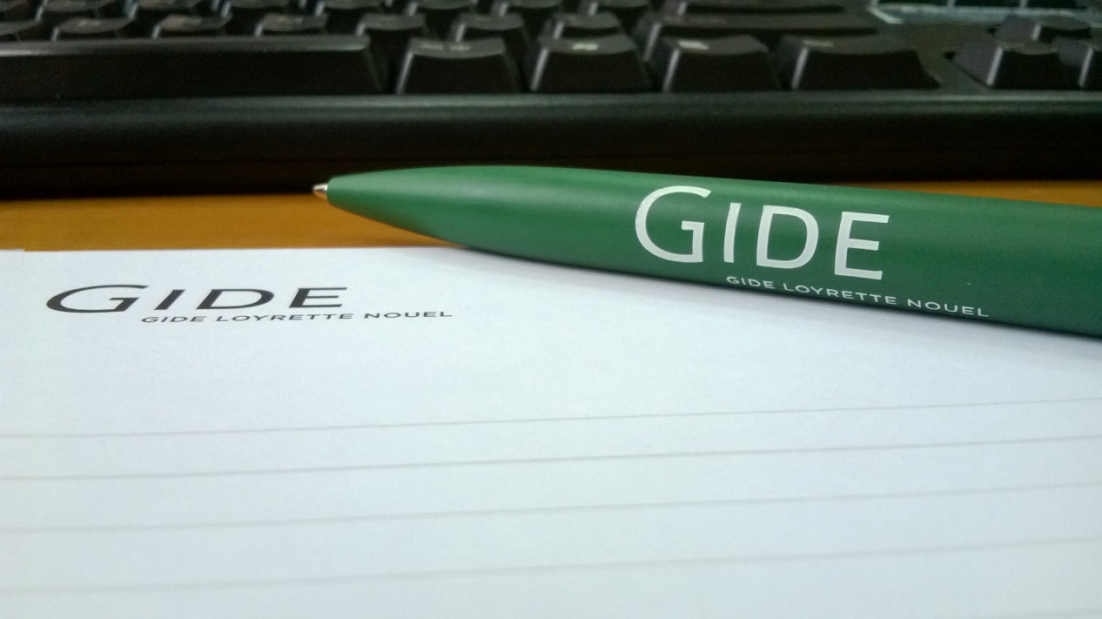
What do other colleagues/former class mates think I do?
IP and M&A expert

Slide 7
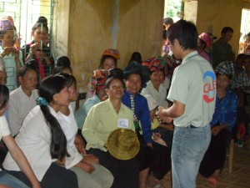
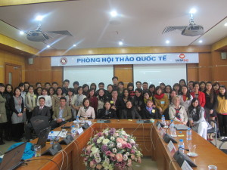
What is my motivation to do pro bono?
HELP VULNERABLE PEOPLE | CREATE A PRO BONO NETWORK

