Slide 1
Mervyn Cheong Advocate & Solicitor Singapore

Slide 2
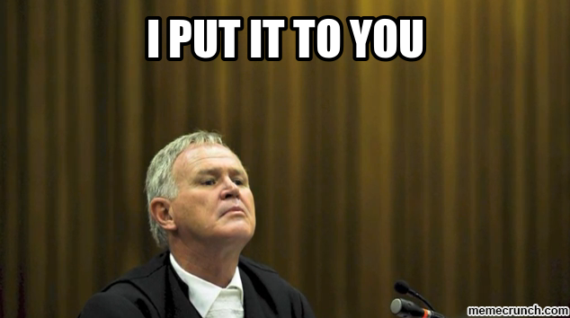
What my friends think I do
Debater
Twisting facts

Slide 3
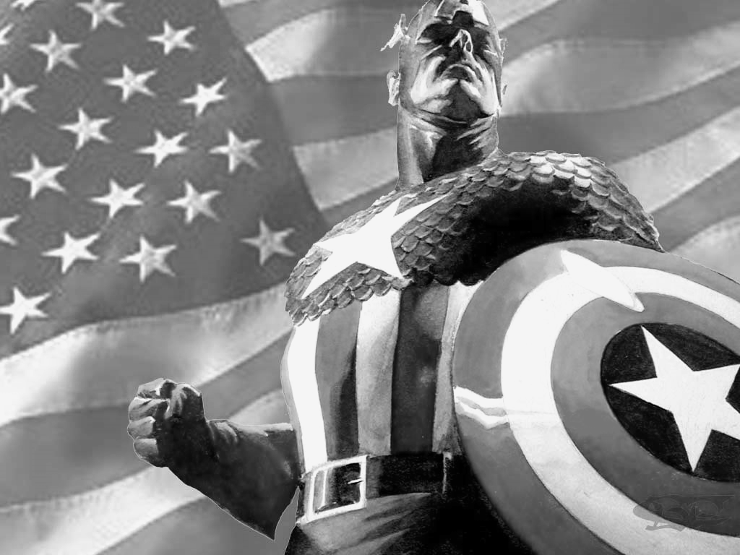
What my family thinks I do
Protector of rights
Defensive shield

Slide 4
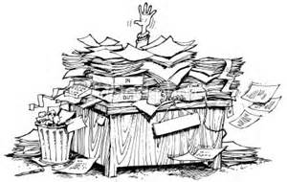
What my former classmates think I do
Buried in files
Private investigator

Slide 5
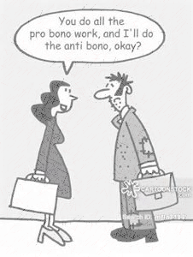
What is my motivation to do pro bono work
The thought that someone may be denied a fair outcome only because he has no knowledge of the law and is incapable of expressing himself coherently

