Slide 1
3rd annual Asia Pro Bono Conference 2014
ICT Strategy workshop for NGOs – ICT4Justice
3 October 2014
Mark Robinson, +65 6868 9808, mark.robinson@hsf.com

Slide 2
Herbert smith freehills
Largest international law firm in APAC
Top 10 international law firm
Large specialist technology law team across APAC

Slide 3
Thoughtfully implemented/applied Technology – streamline processes – scale up pro bono initiatives
Technology
NGOs
Pro bono
Access to justice

Slide 6
how Technology and innovation can promote access to Justice
Justice
Legal portals to ‘triage’ users
Document assembly tools
Social media to expand outreach
Converting manual systems
“In order for rights to be enforced, the people who are affected by their violation or non-enforcement must be aware of them and must have access to courts and tribunals in order to realise them. It is in that context that ICT plays a crucial role”
Richard Goldstone, Co-Chair IBA Rule of Law Action Group
Notes:
Legal Portals that ‘Triage’ users
Single access portals which users are directed to no matter where users enter into the system.
The portal would then allocate the available services so they have the greatest impact on the greatest number of people.
The portal should support technologies familiar to the user group; including computers, tablets, smartphones. (In areas lacking in internet coverage regular phones for calls/ SMS.), and standard software such as Skype and Facetime
Document Assembly Tools
Plain language forms will be produced through plain language interviews for all frequently used court and legal forms.
Users will answer questions regarding their legal matter, and the intelligent forms system will use the information to generate the appropriate form and display it for review.
Small Claims Court in Singapore uses these tools
Social Media to Expand Outreach
Legal aid organizations, courts and NGOs can use social media to expand their outreach to the community by posting information about the availability of legal clinics, as well as videos, self-help resources, court information, etc.
Converting Manual Systems e.g. courts
Promotes efficiency and transparency, e.g. Supreme Court of Indonesia

Slide 7
Technology, innovation and access to Justice – what are the challenges?
Technology has its limits
Confronting barriers to access is essential: Cost; Coverage; Communication; Censorship
Connecting with the disconnected
Technology must be leveraged in innovative ways if it is to reach the ‘hard to reach’ users
Next gen priorities
Moving beyond information dissemination to effective assistance
Starting with end user need (demand) NOT available technology (supply)
Beware of ‘Dr Google’
Foreground context and purpose
Challenge assumptions; older people AND younger people need support
Notes:
Even Technology has its limits
The Four C’s:
Cost -
Coverage – Promoting Universal Access to Internet/ Telephone Networks is vital. NGOs play a key role is lobbying for this.
Communication – Resources need to be actively targeted and promoted; We must assume that users will not just ‘stumble across’ the right support
Censorship – Repressive – and not so repressive - Governments can shut down Communication Networks (Egypt 2013 Revolution), Censor Internet usage (China/SEA), Monitor Communications (NSA scandal in USA); due to the nature of their content matter resources that promote justice can be particularly scrutinitised/ targetted
Development starts with End User Needs NOT available technology
Solutions must be configured abound the target end user and their social need, NOT the available technology: Don't put technology in the driving seat: ICT for justice projects should always be geared to meet a particular social need. All too often people get excited by a particular ‘tool’ and try to apply it to everything.
Remember context and purpose: This may seem obvious but it's often overlooked in ICT for justice projects. To determine context, we must to know the communities we are working with. Make concerted efforts to understand their politics, their sociology and their economics, only then can justice projects be truly useful.
Connecting with the Disconnected
There is evidence that older people and young adults are less likely to look for legal assistance on the internet for quite different reasons. What seems to be the reason for these gaps in access is that some elderly people are not computer literate, while many young people do not realise that they have a legal problem and that assistance may be freely available.
Next Gen Priorities – Moving beyond Information to Advice and Action
The internet has completely transformed the availability of legal information, at least for people with good internet coverage. Some sites, such as AUSTLII, in Australia, freely provide all Australian legislation and leading cases; other sites list how to seek assistance; legal NGOs have sites, Legal Aid has a comprehensive site, as do pro bono clearing houses.
However it should be emphasised that this is only information, it is not advice, there is no analysis or application to a particular set of facts. Beware of the Dr Google syndrome: it can be equally unreliable for clients to self-advise on legal matters, as it is for patients to self-diagnose their illnesses.

Slide 8
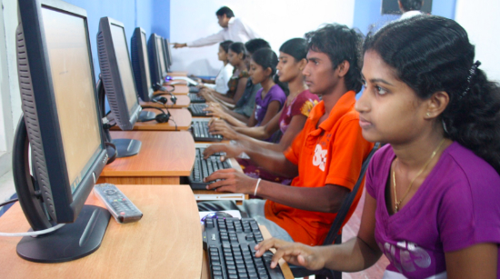
GONOKENDRA: Bangladesh’s IT enabled scheme to promote legal awareness in rural areas
Notes:
The Bangladesh Rural Advancement Committee (BRAC) introduced community-based village libraries known as ‘Gonokendra’ (meaning multi-purpose community access centre) under the BRAC Education Program (BEP) and Continuing Education Programme (CEP) in rural areas of Bangladesh.
NGOs involved including Bangladesh Legal Aid and Services Trust (BLAST), which focuses on the mobilisation of legal resource for women, the poor and other marginalised groups.
The primary objective of the Gonokendra is to build a learning society to bridge the digital divide in village areas of Bangladesh by creating access to reading materials and other continuing education to rural neo-literate, semi- literate, literate communities, and to stimulate interest in acquiring information and encountering new ideas. It was argued that this would create an environment that is conducive to a ‘Learning Society’.
Gonokendra has introduced new Information Technology (IT) programs and renamed the intervention from community based village library to multi-purpose community access center.
The Gonokendra multimedia sessions disseminate legal information that villagers can act upon; such as the prohibition of child marriage, of dowry in marriage, and of merits and consequences of participation in salish (village arbitration), mostly by the poor.
Gonokendra multimedia sessions are continuously making people aware of existing laws on legal and human rights, and encouraging them to seek assistance from a formal court rather than in salish; and of motivating people to raise their voices against the injustices of salish.
Field data demonstrates that participants have grown conscious of many legal issues (divorce law, human rights, etc.) and now take to the courts for legal assistance. They realise that the salish system takes advantage of their ignorance regarding different legal aspects; and that it has imposed injustice upon them on many occasions.

Slide 9
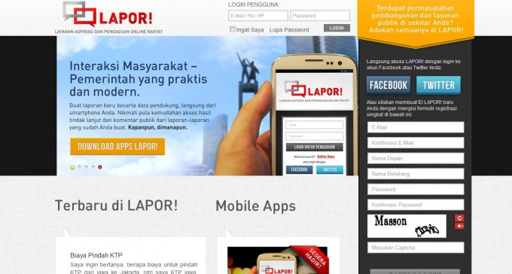
LAPOR!: reducing corruption in Indonesia with crowd reporting
Notes:
LAPOR! (meaning ‘report’ in Indonesian)
In November 2011, UKP4 (Indonesian Presidential Working Unit for Supervision and Management of Development) set up lapor.ukp.go.id, an online portal for complaints about public services, which is accessible also through social media and text message.
The service was launched by Open Government Indonesia, an initiative to promote transparency, public participation, and innovation across government departments, and is coordinated by government unit UKP4.
It is a collaboration between a number of government offices and NGOs such as Transparency International Indonesia.
Lapor! offers users the opportunity to do something about issues like unauthorized administration or facilitation fees in public services more quickly, allowing users can report corruption quickly and easily.
It has a clean and simple look. Users can register themselves easily with Facebook or Twitter, and they can then use the service. Filing a report on the site is very easy and effective. You only need to choose one of the public service categories, then fill in your report and send it. There is an option for you to upload any supporting files too, like pictures or videos of the reported misconduct or act of corruption. Users can then opt to make the report discreetly, and also remain anonymous. Users can also file a report without going online by sending the report via SMS. About 50 percent of the reports made come from handphone messages. There are also apps for Android, and Blackberry, with an iOS version.
As at October 24, 2013 – 225,000 + Registered Users/ 1400 messages per day.
Similar scheme in India started by Janaagraha’s Centre for Citizenship and Democracy.

