Slide 1
Breakout Session 1: Pro bono coordination 101
Thursday 2 October 2014

Slide 2
Breakout Session 1: Pro bono coordination 101 During this session we will discuss:
Developing a plan and laying the foundation for your pro bono practice
Building and maintaining your pro bono practice
Monitoring and measuring the success of your pro bono practice

Slide 3
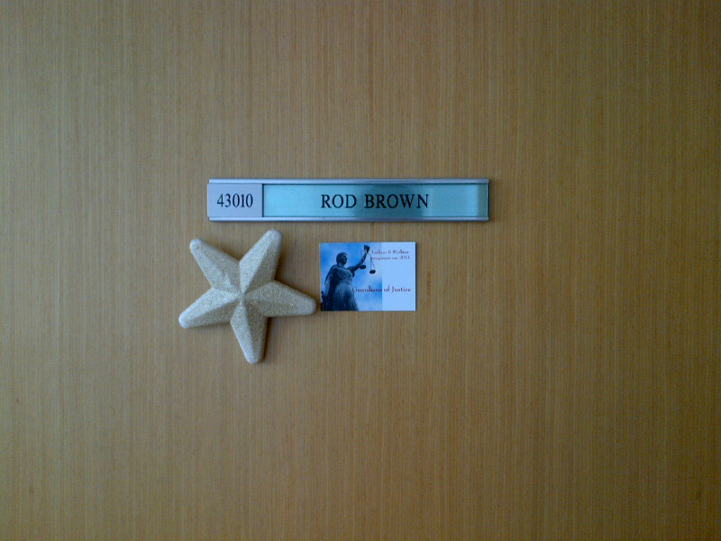
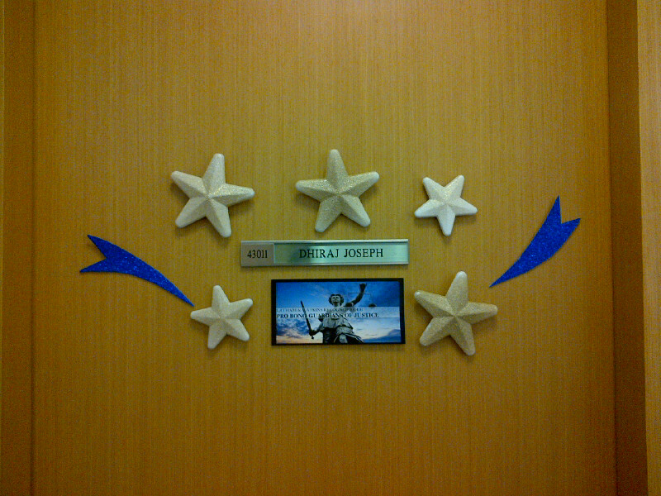
Breakout Session 1: Pro bono coordination 101 Latham & Watkins Gold Stars program

Slide 4
Breakout Session 1: Pro bono coordination 101 Group Challenge!
What do YOU think are the challenges to starting, developing and maintaining a structured pro bono program?
How can you overcome those challenges?

