Slide 1
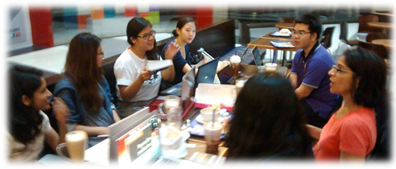
Douglas MacLean
Executive Director

Slide 2
WHERE WE WORK
Host Countries
Home Countries
Japan
Indonesia
PRC (Hong Kong)
Philippines
Singapore
Thailand

Slide 3
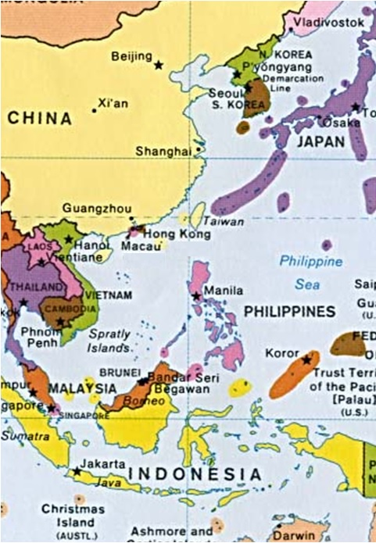

Slide 4
How you can help
SINGAPORE-LICENSED LAWYER?
FOREIGN LAWYER?
Become an advisor. Help clients negotiate settlements and other legal matters. Where the client has gone home, JWB can help find local partners to assist you.
Engage in strategic research, international strategy and logistics. Help JWB in the client’s home country.
NGO /COMMUNITY ORG?
SPONSORSHIP OPPORTUNITIES
If your organization works in one of our target countries, we can help connect you to partners abroad to help meet your migrant worker clients’ legal needs.
Support JWB’s practitioner’s manual launch on 4 November! Sponsorship packages available. Individual donations and corporate support also welcome.

Slide 5
JWB’S Singapore launch
Commemorating JWB’s Launch in Singapore & Publication of Our Strategic Guide
.
Tuesday, 4 November
5:30-7:00pm
NUS Law Faculty
(Bukit Timah Campus)
21 Lower Kent Ridge Rd
Light refreshments served
RSVP encouraged

