Slide 1

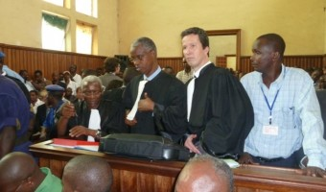
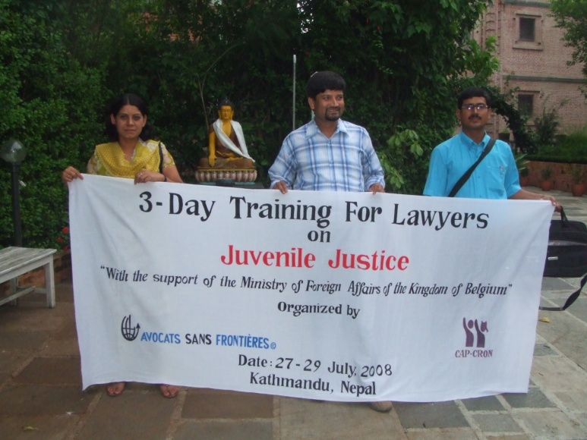
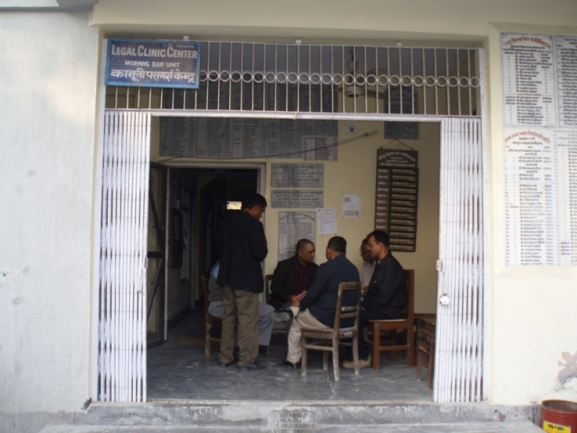
ASF Innovation in Pro Bono
October 3, 2014 Singapore

Slide 2
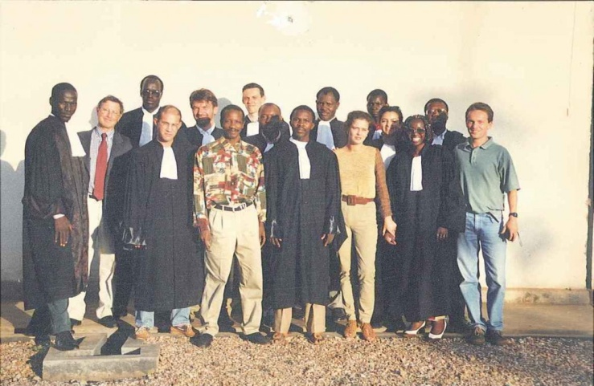


ASF
Convinced that lawyers are a force for social change, a group of solicitors and barristers from several countries launched the idea of Avocats Sans Frontières, Lawyers Without Borders.
Today, ASF implements diverse array of activities to ensure access to justice for the most vulnerable; and establish legal systems that are capable of protecting them.

Slide 3
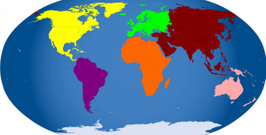
ASF Vision of Pro Bono
Pro Bono as a complementary mechanism of access to justice
Which development is essential at national and international levels

Slide 4
ASF model of Pro Bono
Full integration of Pro Bono into ASF operations: legal assistance, training, trial observation, researches, etc.
In house coordination through the International Legal Network (ILN)
Planning of a set of Pro Bono interventions towards pre identified results and impact for the benefit vulnerable and marginalized populations
IMPACT on ASF
BENEFICIARIES

Slide 5


Pro Bono in action…
For and with people seeking justice
In partnership with lawyers, law societies and legal aid providers
Towards institutional stakeholders in the justice sector
ROJ in Tunisia
Pro Bono local practices in Nepal
Protection of
HRDs in the MENA
and East Africa
Capacity reinforcement in
Myanmar
Organisational support and
Development in West Timor
Creation of the Kigali
Bar Association
Development of the
Legal Aid policy in Burundi
Fight against illegal
Pre trial detention in
DRC and Burundi

Slide 6
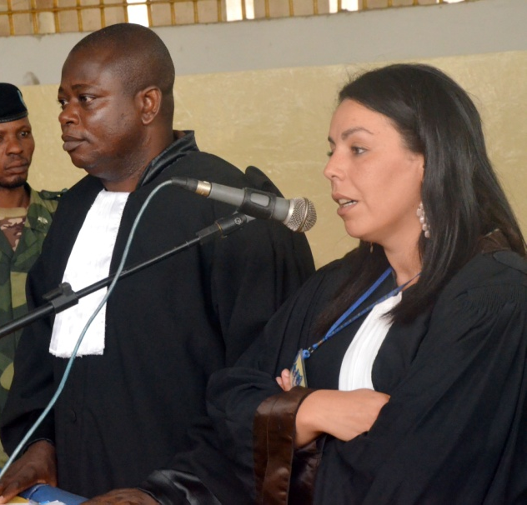
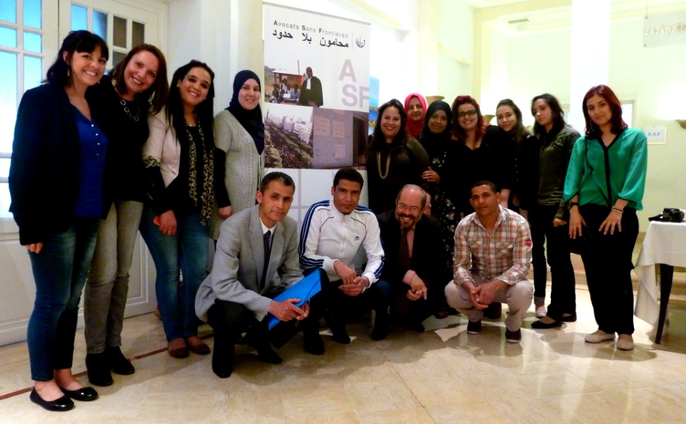
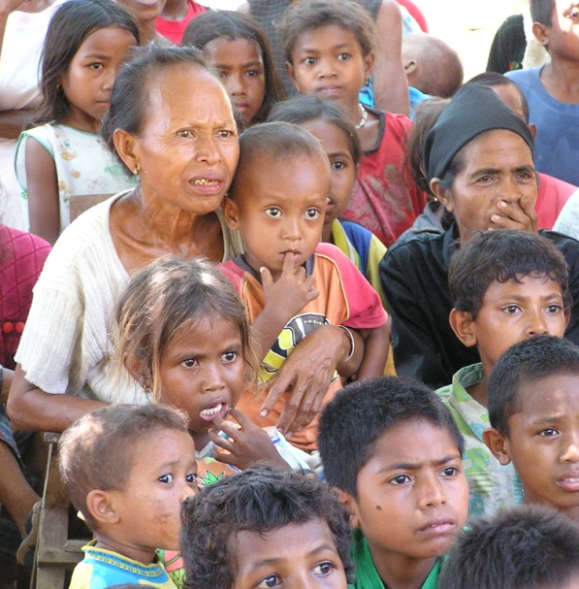


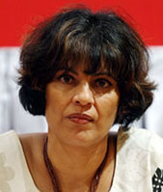
Thank you for your attention
and join the ILN on asf.be!

