Slide 1
Globalisation and pro bono trends
Large law firms with a strong pro bono culture take that to their new offices
Growth in local law firms in emerging economies
Lawyers exposure to pro bono through international legal training and work placements
Exponential growth of corporate lawyer pro bono
Establishment of pro bono targets

Slide 2
Issues for global pro bono
International law firms and lawyers may not have a licence to practise in a local jurisdiction
Cultural awareness
Lack of pro bono legal infrastructure
Need for legal education on concepts such as legal ethics, access to justice, professional responsibility and pro bono

Slide 3
Goals of Lawyer/Client Relationship Session
KNOWLEDGE
Identify the nature of the lawyer/client relationship.
Identify the factors which should be included in a lawyer and client agreement.
Identify when a lawyer and client relationship begins and ends.
Identify the duties of a lawyer to their client (introductory).
SKILLS
Improve the Participant's problem solving skills.
Improve the Participant's drafting skills.
Improve the Participant's critical reasoning skills.
VALUES
Appreciate the importance of a lawyer and client agreement.
Appreciate the importance of confidentiality when engaged by a client.
Appreciate the duties of a lawyer when engaged in a lawyer and client relationship.

Slide 4
DAY 1 13.15 - 16.00 (165 Minutes) |  | Lesson Plan: 'The Lawyer/Client Relationship' (A version for teaching in Vietnam) |  | VIETNAM, APRIL 2014 CAN THO UNI 12/13TH HO CHI MINH CITY 15TH HANOI TRADE UNION UNI 19/20TH
Who? | How Long? | Topic | Activities | Vietnam Code ref: | MATERIALS:
 | 5 | General Introduction (pg 1) | Commence Powerpoint | All | Powerpoint
 | 30 | Topic 1: The Nature of a Lawyer/Client Relationship (pg 2-6) | 1A - Short Lecture 1B - Interview for Can Tho : Minh Nguyen, and for Hanoi: Huyen Dinh-Than | 2 & 3 | Vietnamese Code (distribute)
 | 20 | Topic 2: When does a Lawyer/Client Relationship Commence? (pg 7-13 ) | 2A - Role Play 2B - Group discussion and Q&A | 6 | Script (written)
 | 20 | Topic 3: The Importance of a Client Agreement (pg 14-18) | 3A - Small group discussion and brain storm. | All | Flip Chart & bold markers
 | 35 | Topic 4: What Should be Included in a Lawyer/Client Agreement? (pg 19) | 4A- Draft letter and discuss. 4B- Vietnamese amendment of engagement letter. | 6 - 9 | Engagement letter
 | 25 | Topic 5: Terminating the Relationship (pg 20-25) | 5A - Vote Yes/No Game | 9 & 10 | Use Powerpoint Yes/No Cards
 | Total: 135 min
Notes:
Short PPT on what the class will be covering and the nature of a lawyer client relationship.
We then conducted a short interview of a senior Vietnamese lawyer, to help make is more relevant.
Questions for Interview
Can we start by learning a little more about you? Where did you study law, why did you do it, how long ago did you graduate, and what has your work experience been?
Can we now focus just a bit more on your present job? What is involved in what you now do as a lawyer?
Turning to this topic of the engagement or retainer of the lawyer by the client, you have the unique experience of being both a lawyer, and a client of lawyers. Have you had much experience with engagement or retainer letters?
Arising from your experience, what would you say are the most important issues for young lawyers to focus on when preparing engagement letters with clients?
Are there any particular examples you can give us of interesting experiences you've had as either a lawyer or a client with engagement letters?
Have you ever had to terminate an engagement letter or a retainer; why was that, and how did you go about it?
I think from our discussions, you've had experience of both general retainers and specific retainers. Can you tell us what the difference is and how, if at all, they work together?
Has your employer ever considered suing a lawyer for breach of their retainer? Can you tell us anything about that, and how it was resolved?

Slide 5
Example of A Role Play
Insert Role Play
Notes:
Then role play, to draw out the issues.
Either acted out by students or show video.
Sound not great on this one, but it is the shortest role play
Then we have a discussion with the class as a whole, to draw out the main elements of the video. Questions I've used in the past include:
does the scenario represent a lawyer and client relationship, and if so, why?
What should the lawyer have done to create a formal relationship?
Why is it important to create a formal relationship?
In a small group, write down important things that you think should be included in a lawyer/client agreement (you will be asked to present your answers to the class)
We then ask the students to draft a sample engagement letter and discuss them. We then hand out a very simple pro forma engagement letter.
Finally we address terminating the relationship, and discuss a number of scenarios, and ask the students to vote on whether the relationship can be terminated

Slide 6
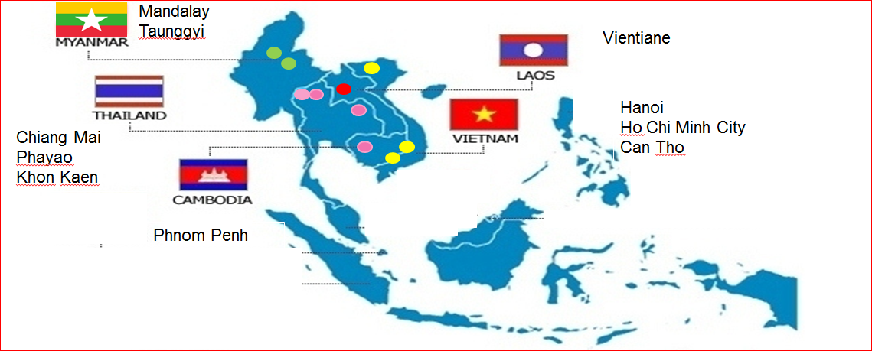
Testing Workshops
Notes:
Testing Workshops
To introduce the curriculum
To demonstrate the lesson
To train lecturers how to use the curriculum in legal ethics courses
To refine the materials
Testing The Content
The curriculum is being tested in each legal jurisdiction where it is to be used, to ensure it is understandable, legally accurate and culturally appropriate
At the end of each workshop, feedback is obtained from participants and presenters
Next month the project partners will meet again in Sydney to review and measure the progress of the project.

Slide 7
Training Workshop – January 2014, Faculty of Law and Political Science Clinical Legal Education (FLP CLE) National University of Laos, Vientiane, Laos

