Slide 1
ສະພາທະນາຍຄວາມແຫ່ງ ສປປລາວ Lao P D R Bar Association ໂຄງການຊ່ວຍເຫລືອແລະໃຫ້ຄວາມຮູ້ດ້ານກົດໝາຍຂອງສະພາທະນາຍຄວາມ ແຫ່ງ ສປປລາວ Legal aid and Legal Education Project ອຸປະຖຳໂດຍ: ໂຄງການ ມູນນິທິເອເຊຍ Supported by: Asia foundation Project

Slide 2
I. Objective 1. The objective of legal aid projects are to provide to justice assessment, especially for the poor 2. Poor people include women and child who have problems or legal issues but they can not to access to justice system 3. Because they cannot pay lawyers’ fees and they do not understand lawyers’ roles 4. The people can get consultation including help from lawyers, but they do not pay for anything

Slide 3
II. The target groups of Legal aid 1. Poor people, women, children (especially orphans, destitute children, abused children) 2. Marginalized people: disabled people, people in rural areas, people who cannot access to justice 3. Isolated people, people whose legal rights have been violated.

Slide 4
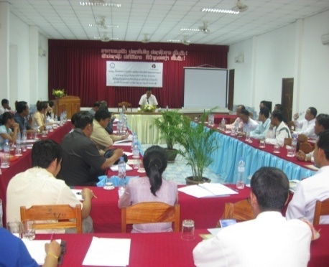
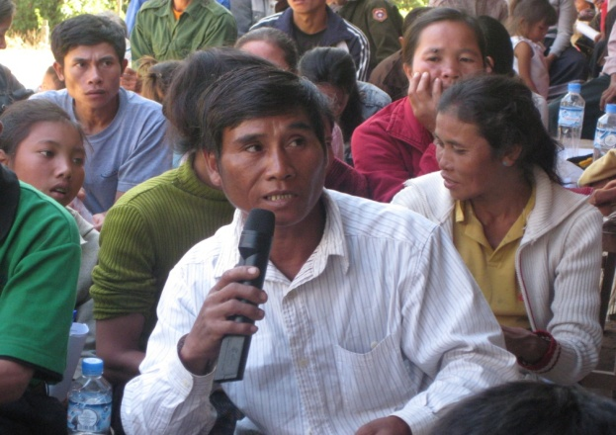
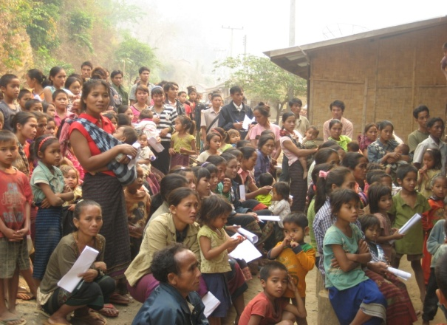
III. Legal help provided by Laos Bar Association 1. ( 57,468 ຄົນ ) Legal dissemination outreach 2. (2,730 ຄົນ) Free legal consultation 3. ( 102 ຄະດີ) Legal aid cases 4. ( 280 ຄົນ ) Paralegal training

Slide 5
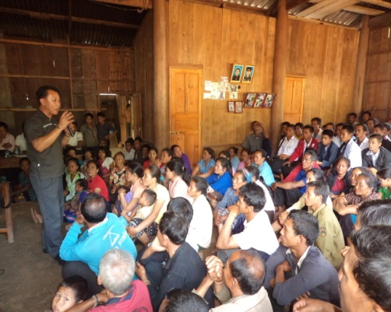
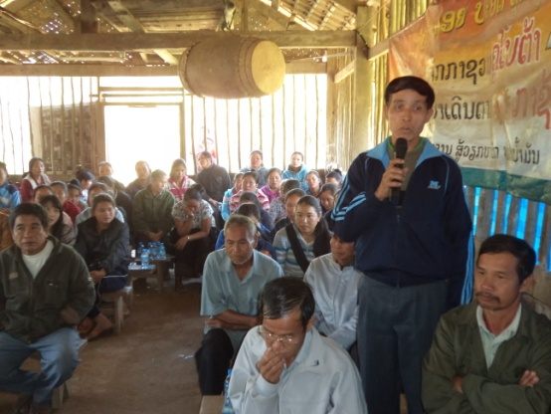
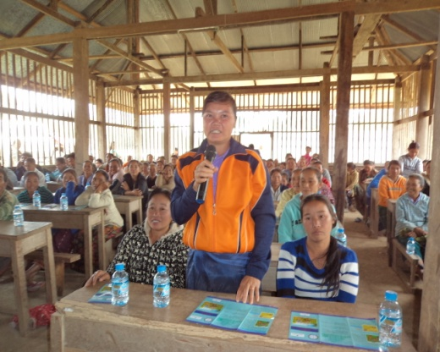
1. ¡ò 1. Legal dissemination outreach activities 1.1 Build teams who will go to communities 1.2 Identify the communities 1.3 Identify the topics to be taught 1.4 Advertise and announce 1.5 Encourage the communities to expand the knowledge

Slide 6
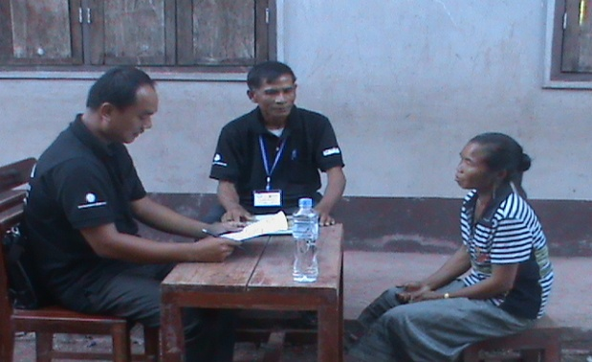
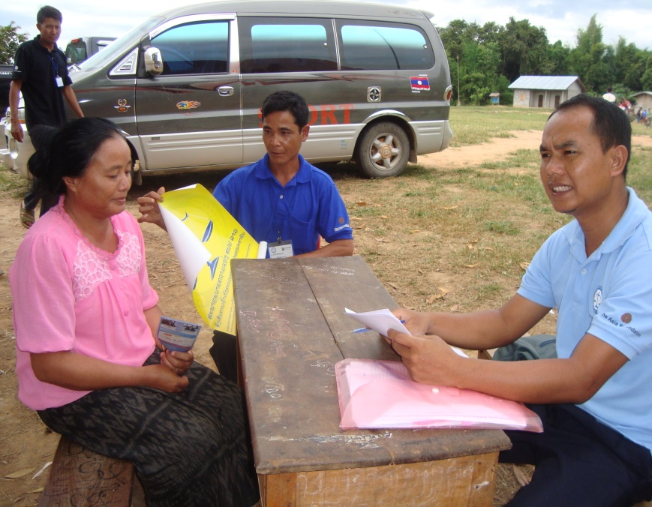
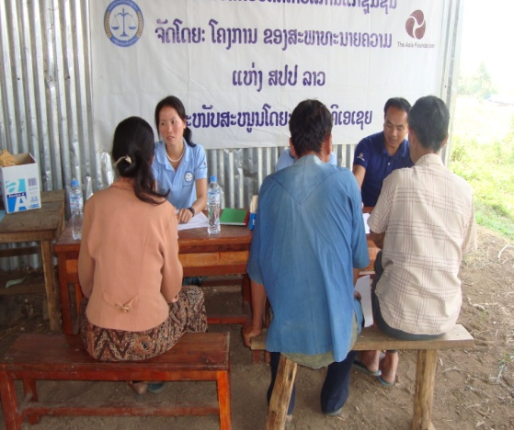
2. Free legal consultation A. Provide legal advice at the office B. Mobile legal advice C. Provide legal advice via telephone

Slide 7
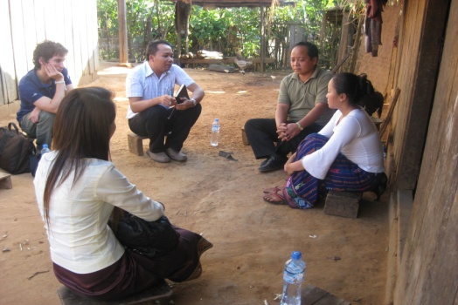
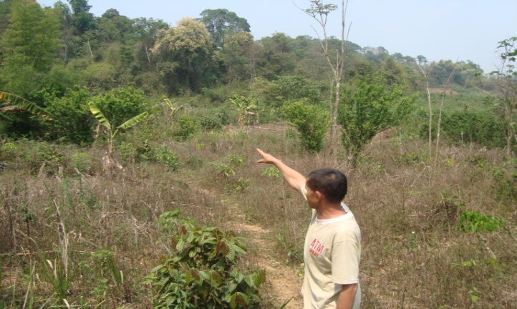
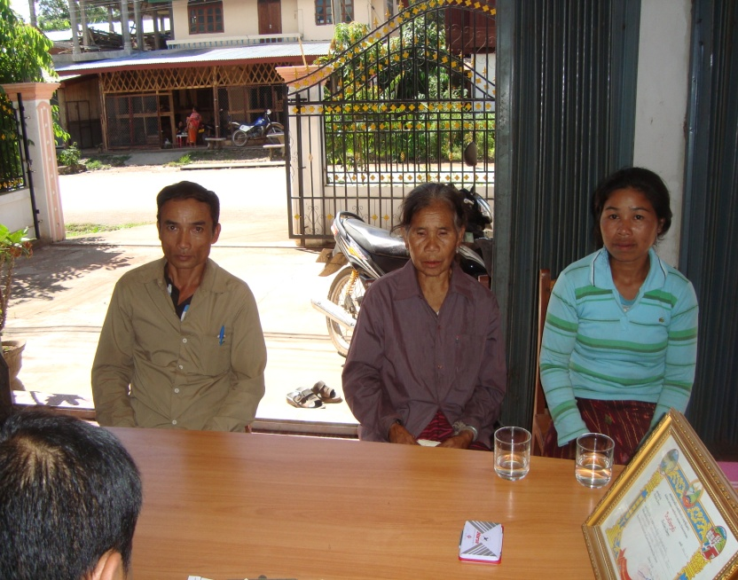
3. Legal aid case activities 1. Poor people, marginalized people 2. Women and children who are abused 3. Women and children who are in trafficking risk 4. People with income under 5.000.000 million kip 5. People who cannot access justice

Slide 8
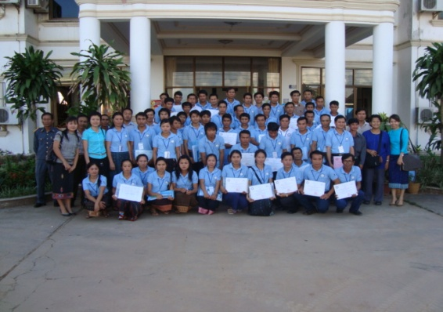
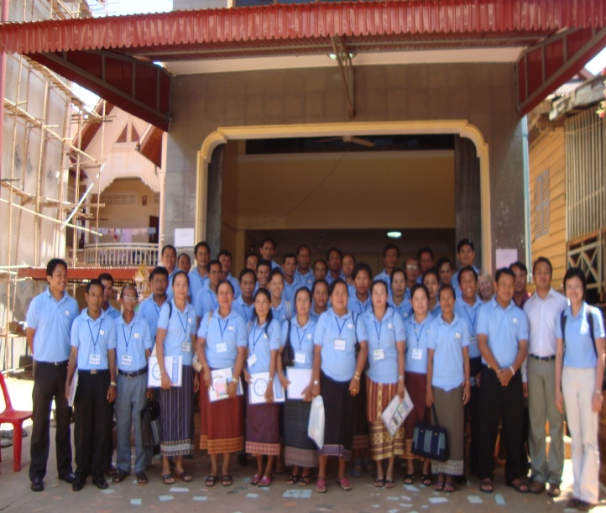
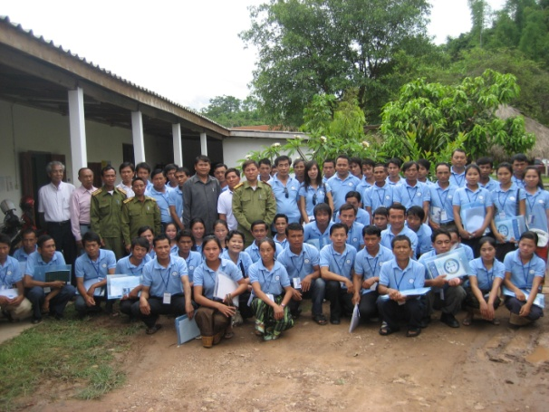
4. Paralegal training Who are our volunteers? Our paralegal volunteers are trained in law, access to justice to help people/communities access justice, and legal assistance from the bar association.

Slide 9
Thank you! Lao P D R Bar Association Tel/fax: 856-21-990445-46, 856-21-353953 website: www.laobar.org Legal aid Clinic Northern Provinces Tel/Fax: 856-81—211548 Legal aid Clinic Southern Provinces Tel/Fax: 856-31—252 410

